Slide 1


The new wafer design
Alexandre Hennessy, Vagelis Gkougkousis
03/02/2026

Slide 2
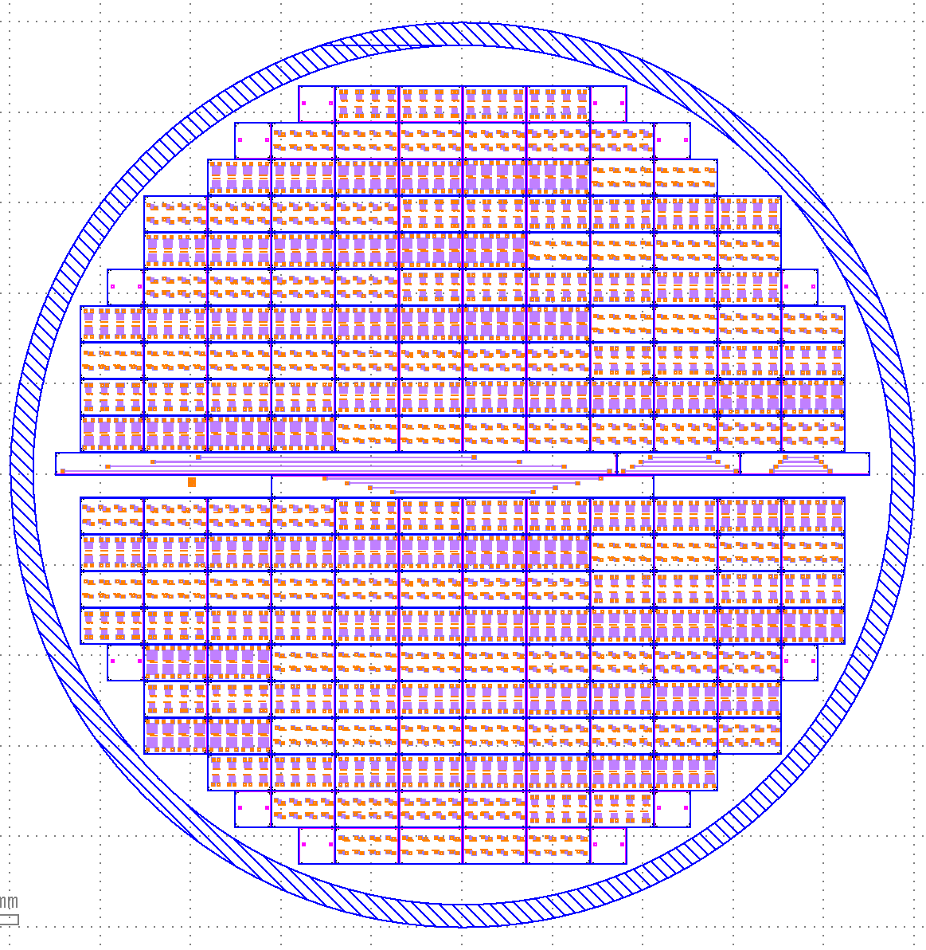
Improved wafer layout:
Layout information:
160 unique SNSPDs
47 SNSPD die and 18 test structures
7 duplicates with variable relative positions
50μm dicing lines
50μm marker width
Key differences:
Bigger chips with 8 SNSPDs instead of 1
Less photolithography required
Silicon wafer:
Monocrystalline Fz Si
<100> or <111> orientation
4” diameter
525μm thickness
Double sided polish
P-type boron doping
10KOhm.cm
03/02/2026
A. Hennessy, E. L. Gkougkousis
1

Slide 3

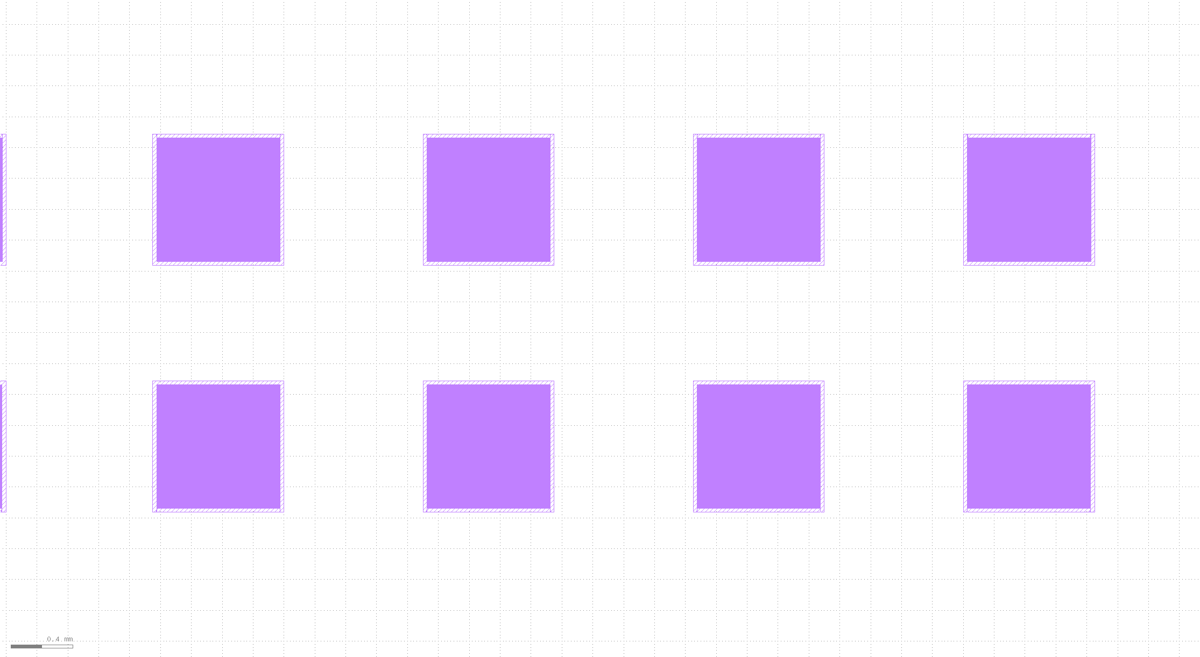
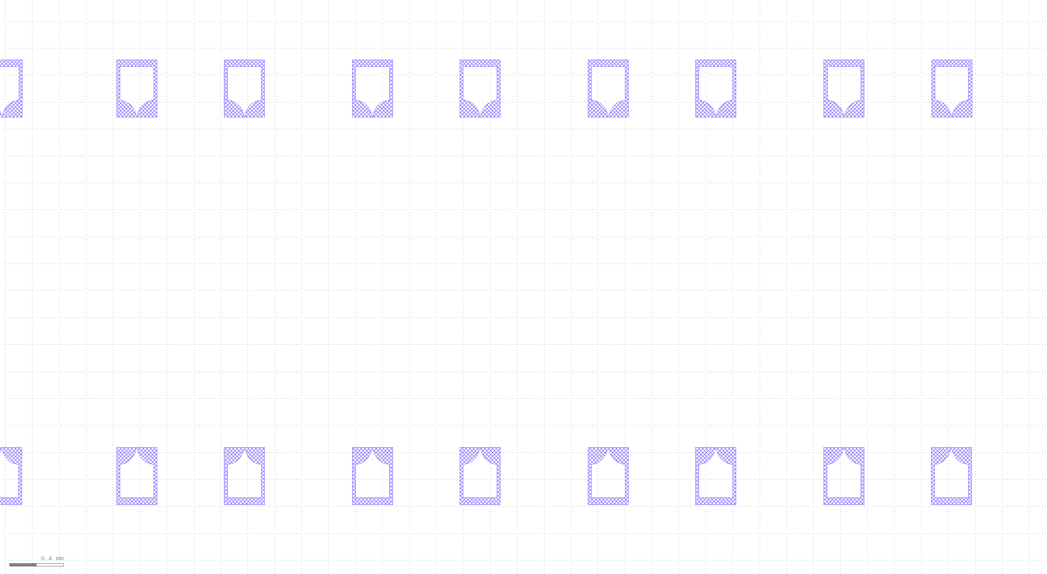


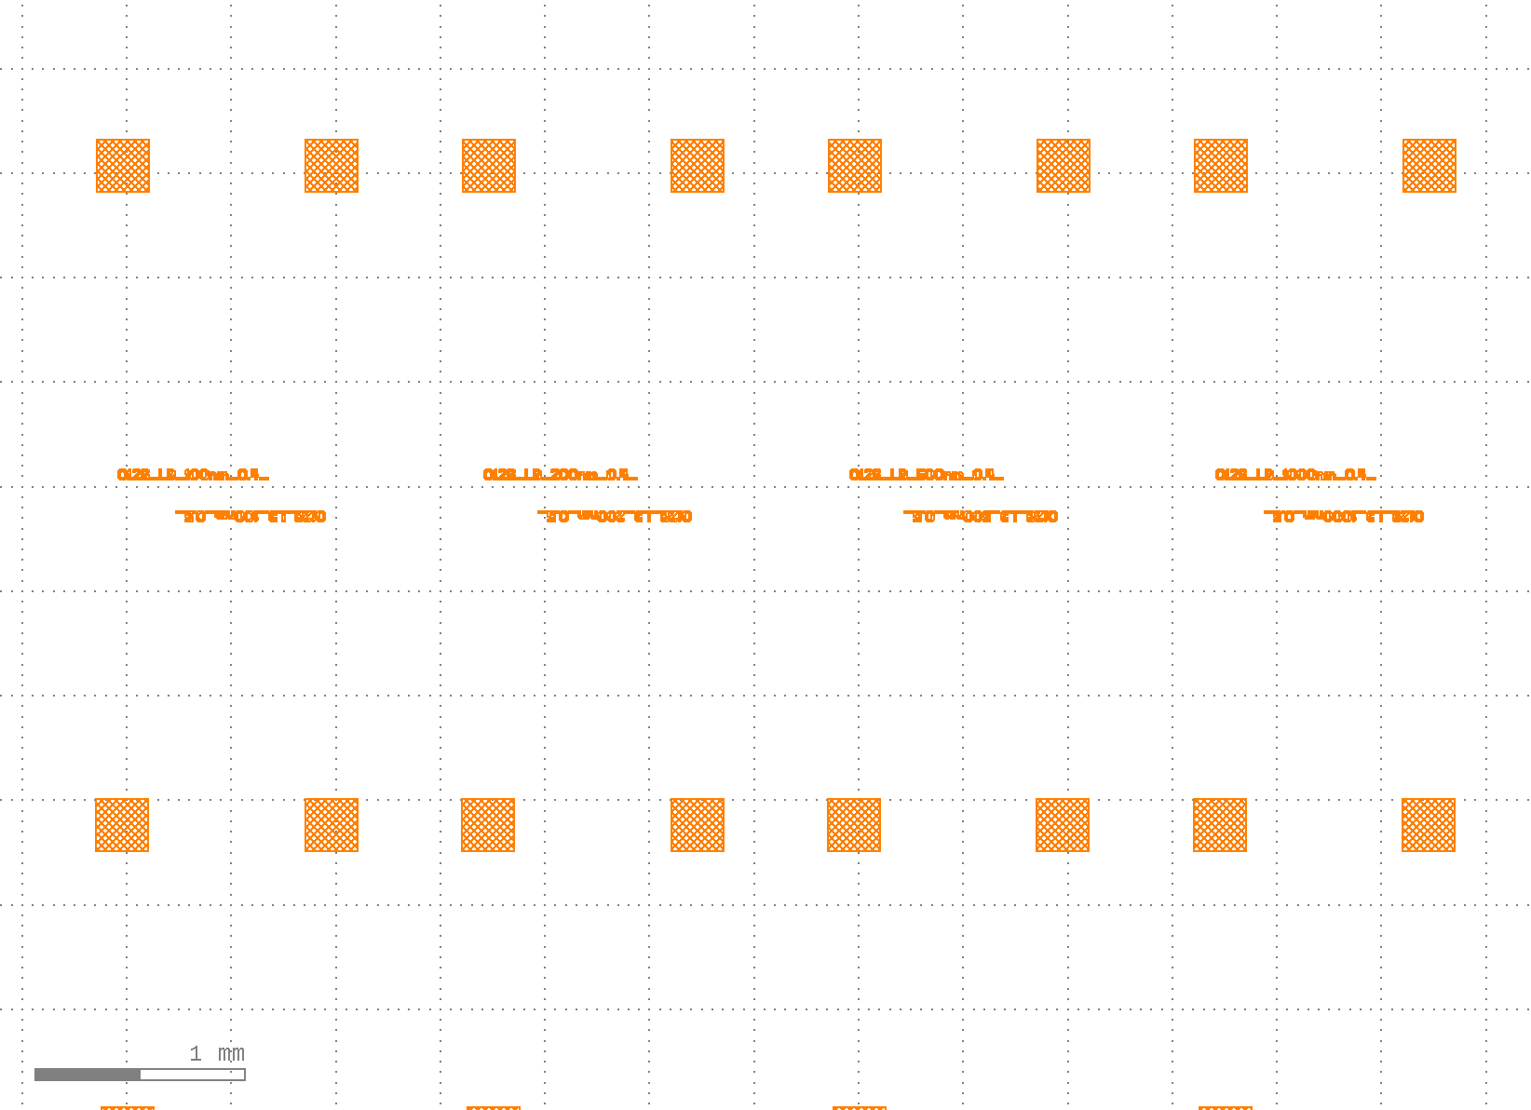
Masks:
Narrow e-beam lithography (SNSPDs, 30nm)
Wide e-beam lithography (100nm)
Chip gold marker, 100nm wide, photolithography
Gold pads and SNSPD identifier
Dicing lines etching, 2μm deep and 100nm wide
Alignment markers, 20μm marks
03/02/2026
A. Hennessy, E. L. Gkougkousis
2

Slide 4
SNSPD characteristics:
Total: 160 unique SNSPDs
Pixel size | Width | Fill factor
100 | 100 | 30%
 |  | 40%
 |  | 50%
 |  | 60%
 | 200 | 30%
 |  | 40%
 |  | 50%
 |  | 60%
 | 500 | 30%
 |  | 40%
 |  | 50%
 |  | 60%
 | 1000 | 30%
 |  | 40%
 |  | 50%
 |  | 60%
Pixel size | Width | Fill factor
200 | 100 | 30%
 |  | 40%
 |  | 50%
 |  | 60%
 | 200 | 30%
 |  | 40%
 |  | 50%
 |  | 60%
 | 500 | 30%
 |  | 40%
 |  | 50%
 |  | 60%
 | 1000 | 30%
 |  | 40%
 |  | 50%
 |  | 60%
Pixel size | Width | Fill factor
300 | 100 | 30%
 |  | 40%
 |  | 50%
 |  | 60%
 | 200 | 30%
 |  | 40%
 |  | 50%
 |  | 60%
 | 500 | 30%
 |  | 40%
 |  | 50%
 |  | 60%
 | 1000 | 30%
 |  | 40%
 |  | 50%
 |  | 60%
Pixel size | Width | Fill factor
1000 | 100 | 30%
 |  | 40%
 |  | 50%
 |  | 60%
 | 200 | 30%
 |  | 40%
 |  | 50%
 |  | 60%
 | 500 | 30%
 |  | 40%
 |  | 50%
 |  | 60%
 | 1000 | 30%
 |  | 40%
 |  | 50%
 |  | 60%
03/02/2026
A. Hennessy, E. L. Gkougkousis
3

Slide 5
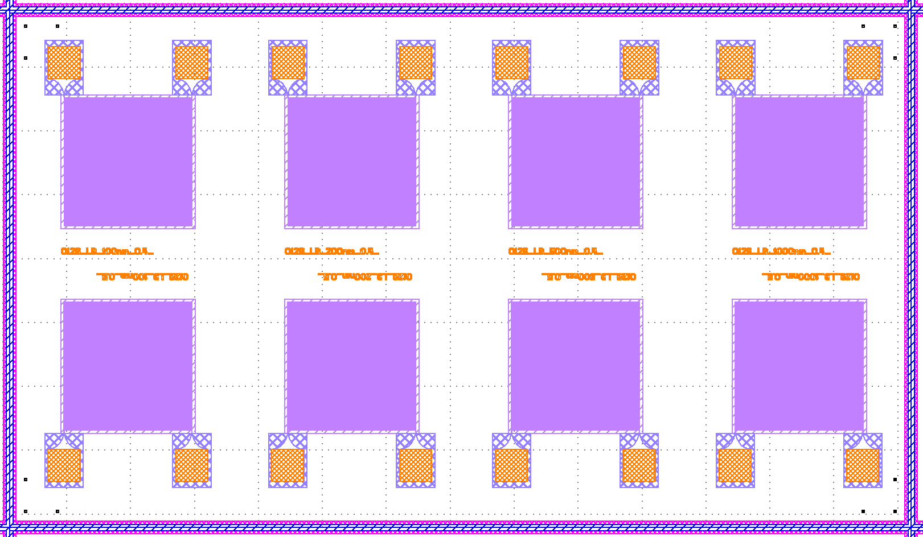
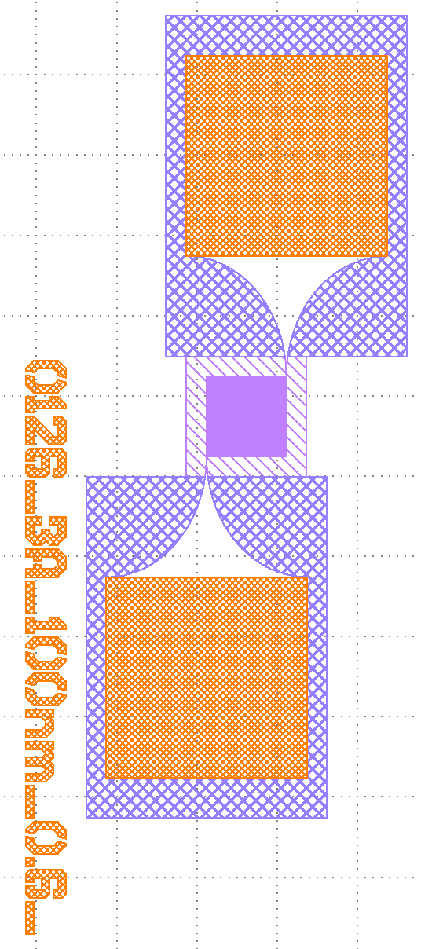
Die geometry:
7.05mm
200μm
450μm
250μm
450μm
450μm
700μm
700μm
700μm
550μm
550μm
550μm
550μm
250μm
50μm
4.05mm
Second SNSPD layout for pixels <500μm
03/02/2026
A. Hennessy, E. L. Gkougkousis
4

Slide 6
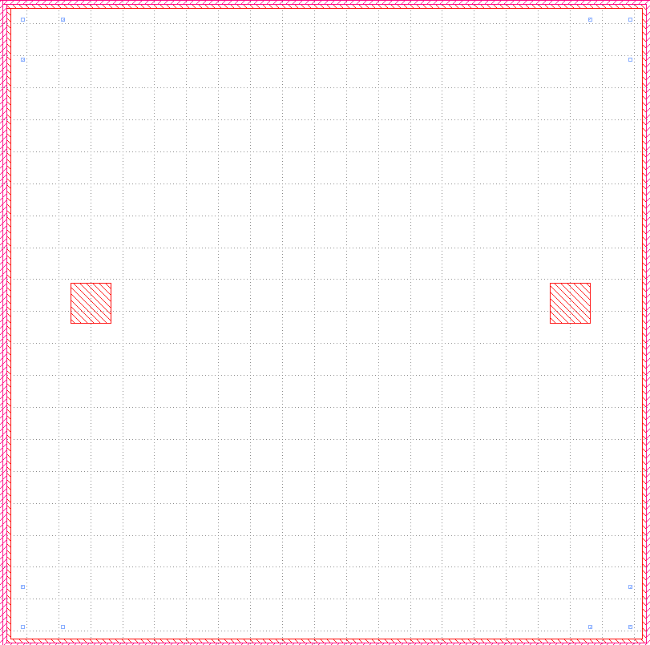
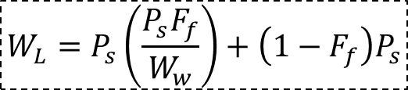
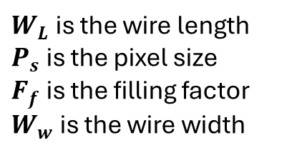
Test structures (1):
4mm
4mm
Inductance measurements with single wires:
100nm wire width
Same length as other SNSPDs on the wafer
Accurate comparison between SNSPD and wire inductance
Length varies from 3 to 60mm
$$W_{L}=P_{s}\left(\frac{P_{s}F_{f}}{W_{w}}\right)+\left(1−F_{f}\right)P_{s}$$
Film uniformity measurements:
4x4mm die
Measurement of:
  Residual resistivity ratio
  RT(B), including ΔT
  London penetration depth
  Coherence length
  Diffusion coefficient
$W_{L}$ is the wire length
$P_{s}$ is the pixel size
$F_{f}$ is the filling factor
$W_{w}$ is the wire width
03/02/2026
A. Hennessy, E. L. Gkougkousis
5

Slide 7
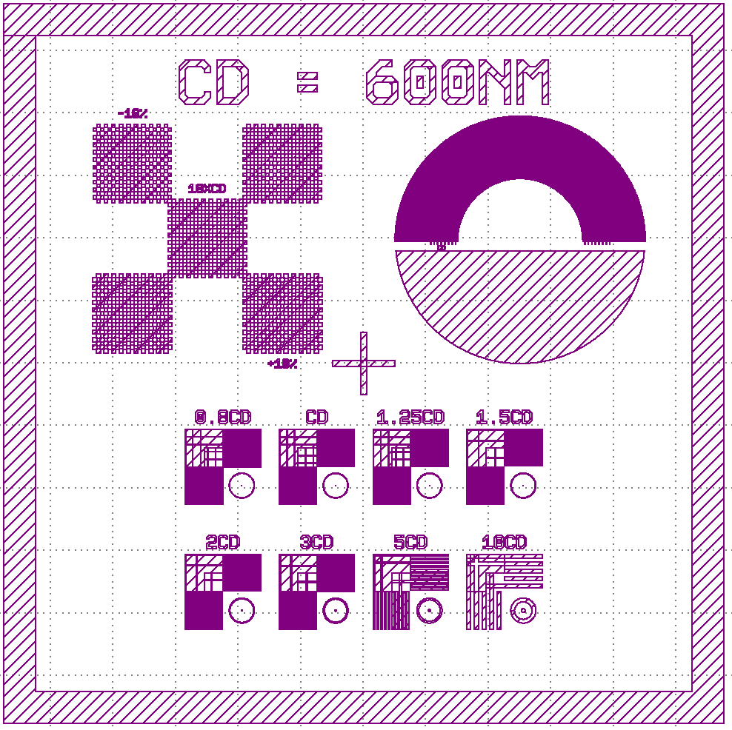

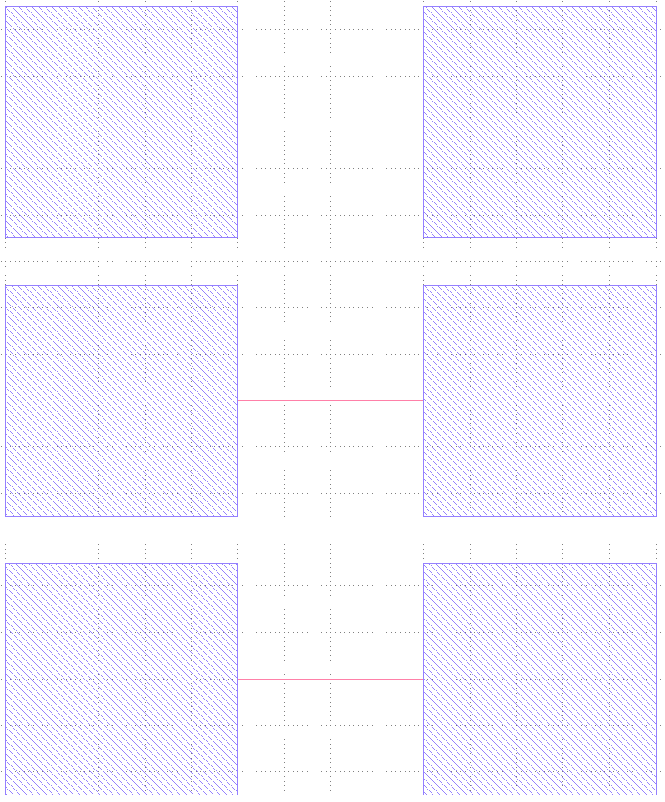
Test structures (2):
Proximity effect of wires:
Electrical characterization for 1 to 3 wires with varying wire distances (corresponding to the SNSPD Fill factors on the wafer)
100nm
100nm
100nm
100nm
Standard litho resolution test:
Verify the capabilities of lithography, including:
  Meander proximity effect
  Beam resolution
  Scribing speed and error rate
  Overhang or underhang creation
100nm
03/02/2026
A. Hennessy, E. L. Gkougkousis
6

Slide 8
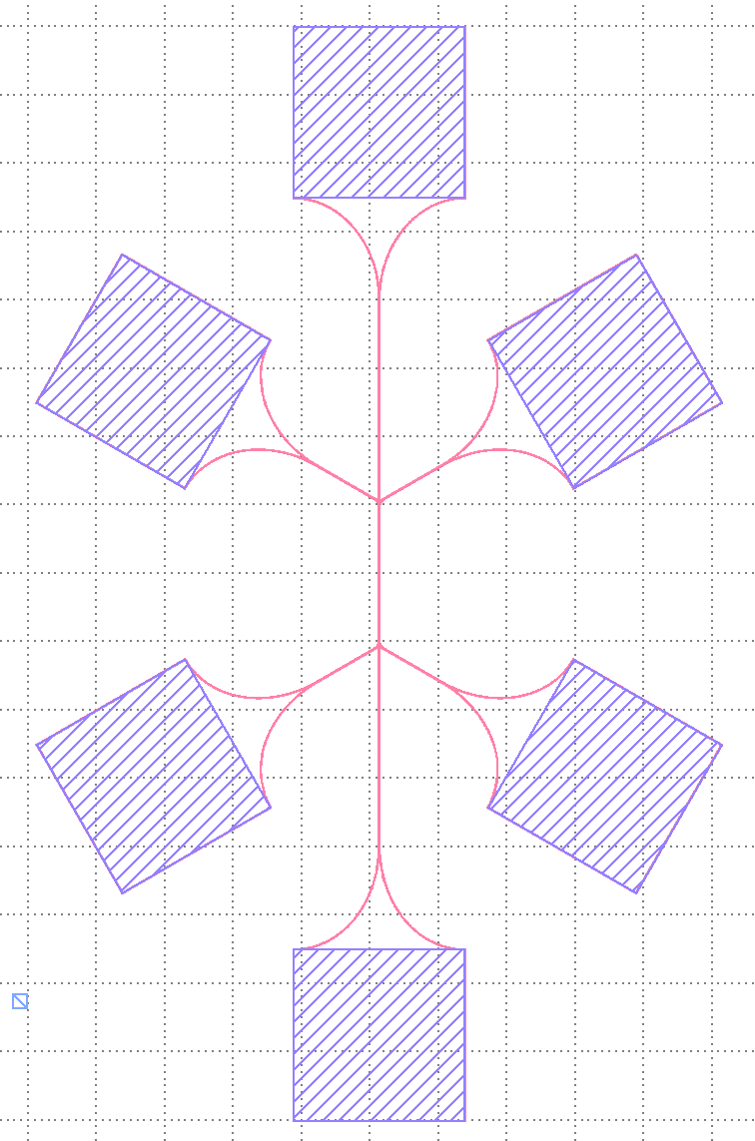
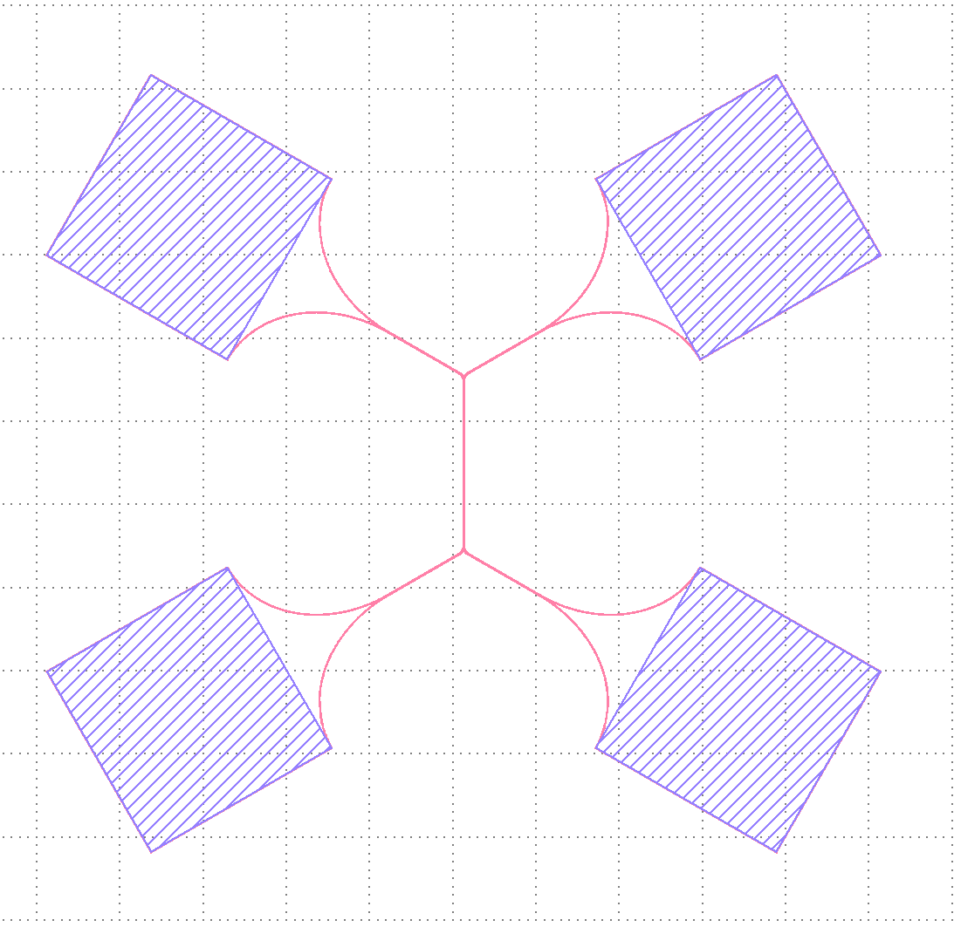
Test structures (3):
Proximity effect of wires:
Electrical characterization for 2 and 3 wires with varying wire distances (corresponding to the SNSPD Fill factors on the wafer) and isolated contact pads
3-Wire measurement
2-Wire measurement
03/02/2026
A. Hennessy, E. L. Gkougkousis
7

Slide 9
Time/Cost analysis:
Time difference:
Time and cost wise, the bulk of the time is taken by the setup of each machine (billable by the hour)
Main changes:
SPTS rapier photolithography:
  4 extra hours → 200 CHF required
RAITH e-beam lithography:
  4 extra hours → 200 CHF required
Heidelberg photolithography:
  4 extra hours → 130 CHF required
Metric: | Fully used wafer (~1000SNSPDs) | Only 16 SNSPDs
Time difference: | 45 h | 33 h
Cost difference: | 3780 CHF | 3000 CHF
Wafer: | One wafer per production | One wafer for several productions
03/02/2026
A. Hennessy, E. L. Gkougkousis
8

Slide 10






Conventional SNSPD fabrication:
Step 1: Creation of the dicing lines
Step 2: Thin film deposition (NbN, NbTiN) using magnetron sputtering
Step 3: SNSPD patterning though 2 steps of e-Beam lithography (Coarse + Fine)
Step 4: Gold deposition through evaporation on lift-off resist
Step 5: Lift-off and cleaning
Next steps: After fabrication, the wafer can be dice into single SNSPD die.
SEM/AFM pictures of each sample and, for the future, the samples can be bonded at CMi.
03/02/2026
A. Hennessy, E. L. Gkougkousis
9

