Slide 1
SNSPD fabrication process
Alexandre Hennessy, Vagelis Gkougkousis
20/01/2026

Slide 2
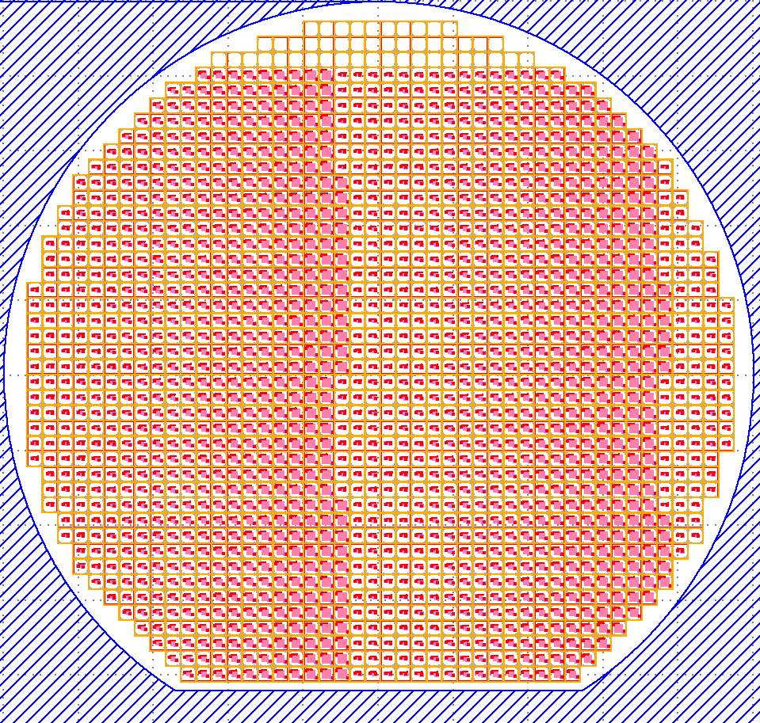
Typical wafer layout:
Naming convention: MMYY_Name_WW_FF_Copy
Name | Size (nm)
BA | 100
BM | 200
BBB | 300
FB | 400
CB | 500
KB | 600
BB | 700
RB | 800
SB | 900
LB | 1000
Wire Width(nm)
100
300
500
1000
4000
10000
Filling Factor (%)
30
40
50
60
70
SNSPDs:
~1600 in total (with 4 quadrant duplicate)
Each installed in a 2.1x2.1mm square
10x6x5 matrix of parameters
Test samples:
Single wires
Proximity effect measurements
2x2mm and 5x5mm films
20/01/2026
A. Hennessy, E. L. Gkougkousis
1

Slide 3
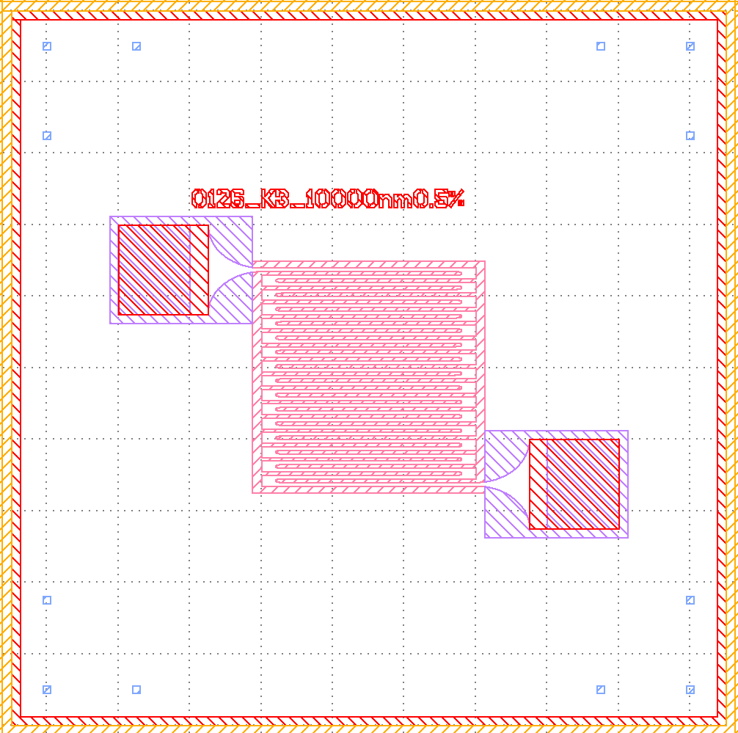
Typical SNSPD layout:
Alignment markers
SNSPD identifier
Negative SNSPD made with fine e-Beam
Dicing Lines
Gold pads
Rough e-beam lithography
Gold marker
20/01/2026
A. Hennessy, E. L. Gkougkousis
2

Slide 4




Mask layout:
Large e-beam mask:
Removes large area around SNSPD and under gold pads to prevent ballast effect
SNSPD Mask:
Only meanders
precision of 10nm
Gold Mask:
Gold contact pads
Exclusion zone around the dicing lines
Names of the SNSPDs
Dicing lines:
100um wide
2.1x2.1mm squares
2um DRIE
20/01/2026
A. Hennessy, E. L. Gkougkousis
3

Slide 5

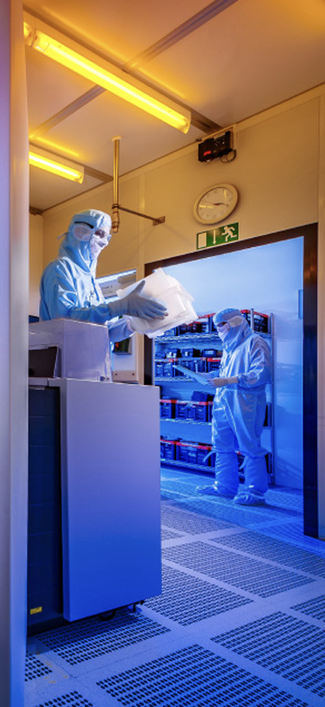

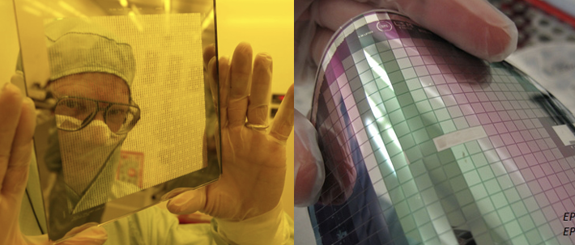
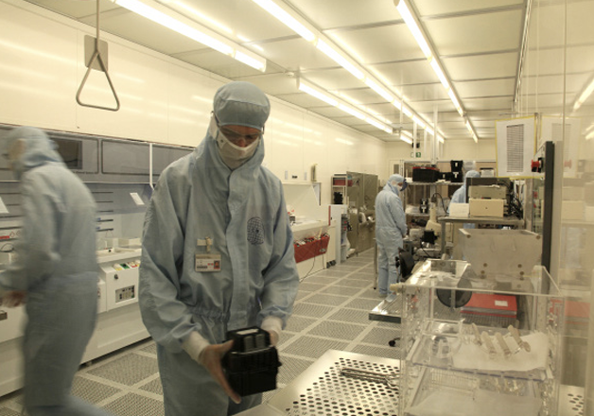
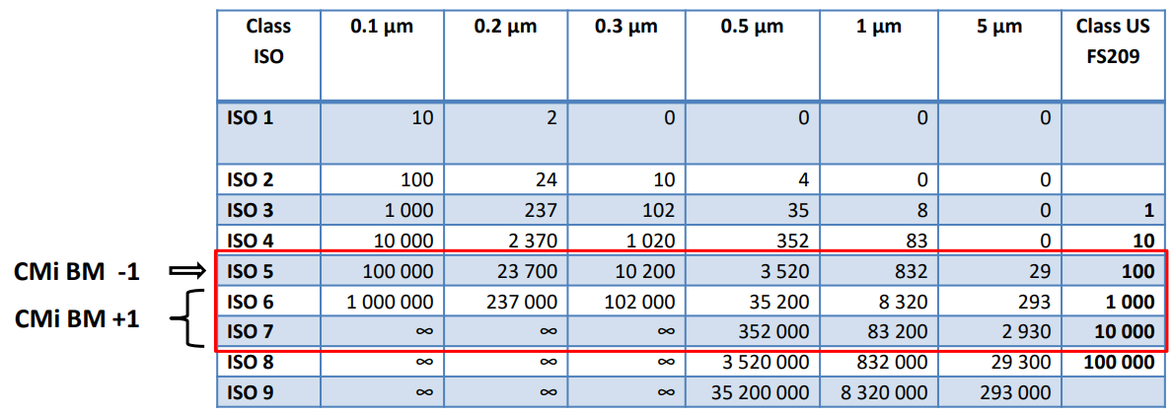
CMi facility:
The Center for MicroNano technologies, located at the EPFL offers a wide range of tools and processes instrumental to the fabrication of SNSPDs.
Important information:
ISO7(BM+1) for unconventional processes
ISO5 (BM-1) in processing bays and wafer manipulation
24/7 access for most tools (no access to staff outside of business hours) =
Access to NbN and NbTiN, no MgB2 possibility for now
20/01/2026
A. Hennessy, E. L. Gkougkousis
4

Slide 6






Conventional SNSPD fabrication:
Step 1:Alignement markers and Dicing lines through photolithography combined with DRIE
Step 2: Thin film deposition (NbN, NbTiN) using magnetron sputtering
Step 3: SNSPD patterning though 2 steps of e-Beam lithography (Coarse + Fine)
Step 4: Gold deposition through evaporation on lift-off resist
Step 5: Lift-off and cleaning
Next steps: After fabrication, the wafer can be dice into single SNSPD die.
SEM/AFM pictures of each sample and, for the future, the samples can be bonded at Cmi.
20/01/2026
A. Hennessy, E. L. Gkougkousis
5

Slide 7
Conventional SNSPD fabrication:
Step No. | Process | Instrument | Description | Process Block
1 | RCA cleaning | Plade RCA |  | Alignment markers & Dicing lines
2 | Resist coating | ACS200 | Resist AZ 10xT
3 | Photoresist softbake | ACS200 | 110°C for 120s
4 | Photolithography | Heidelberg instruments MLA150 | 375nm, 130mJ/cm2
5 | Development | ACS200 | AZ400K:Water 1:3.5 ratio, 50s
6 | Deep Reactive Ion Etching (DRIE) | SPTS Rapier | 2 um depth
7 | Resist removal | ACS200 | Tepla + wet remover
8 | Thin film deposition | Alliance concept DP650 |  | SNSPD meander etching
9 | E-beam resist coating | SAWATEC SM150 | PMMA, 70nm, 3000rpm, 40s
10 | E-beam resist soft baking | Präziterm hot plate | 180°C for 300s
11 | E-beam lithography | RAITH EBPG5000+
12 | PMMA development | Plade solvents wet bench | MiBK:IPA 1:3 ratio for 60s
13 | Rinsing | Plade solvents wet bench | IPA for 60s
14 | Reactive ion etching (RIE) | Veeco Nexus IBE350
15 | E-beam resist removal | Plade solvents wet bench | Acetone
20/01/2026
A. Hennessy, E. L. Gkougkousis
6

Slide 8
Conventional SNSPD fabrication:
Step No. | Process | Instrument | Description | Process Block
16 | Photoresist coating | Sawatec SM200 | AZ1512 on LOR, 3450rpm for 30s | Gold pad deposition
17 | Photoresist softbake | EVG150 | 110C for 90s
18 | Photolithography | Heidelberg instruments MLA150 | 375nm, 130mJ/cm2
19 | Post exposure bake | EVG150 | 115C for 90s
20 | Development | EVG150 | AZ726MIF, 50s
21 | Back side rinse | Plade solvents wet bench | SRD bath
22 | Drying | Plade solvents wet bench
23 | In-situ small ions etch | Leybold optics LAB 600H
24 | Gold deposition | Leybold optics LAB 600H | Evaporation
25 | Lift-off | Arias lift-off bench | SVC14 overnight
26 | Wafer cleaning | Plade solvents wet bench | IPA for 60s
27 | Hot plate drying | Pratziterm hot plate | 180C for 300s
28 | SEM/AFM imaging |  |  | Final steps
29 | Dicing
30 | Bonding
20/01/2026
A. Hennessy, E. L. Gkougkousis
7

Slide 9
Unconventional thick SNSPDs:
Why do we need this ? According to simulation, to get a near 100% detection efficiency of MIPs, the SNSPDs need to be several micrometers thick.
The issues ? This hasn’t been done before, so we don’t know how to fabricate them or if they can even detect particles through cooper pair breaking
Step 1: Oxide layer growth (up to 3um) with the Centrotherm furnaces
Step 2: Meander well creation using E-beam lithography and Deep reactive ion etching
Step 3: Thin film deposition (Magnetron sputtering) and photoresist coating for lift-off (This step should be modified)
Many open questions left:
Can we use e-beam litho on lift-off photoresist?
How thick do these photoresists have to be ?
Can we etch directly into Si ?
Step 4: Lift-off at the using SVC14
Step 5: Gold pad deposition with evaporation and Lift-off at the using SVC14
20/01/2026
A. Hennessy, E. L. Gkougkousis
8

Slide 10
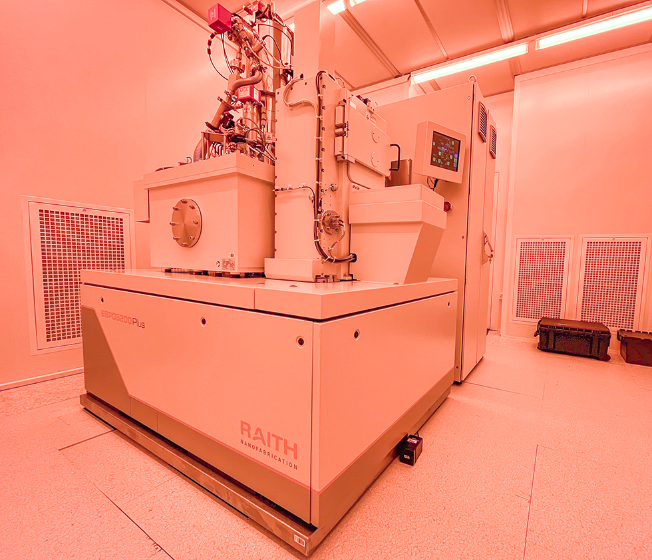




Lithography & Etching:
Step 1: Spin coat a layer of resist onto the wafer. Typical thickness is around 2um for photo and e-beam resists
Step 2: Use either photolithography or electron beam lithography onto the resist. Photolitho has a precion down to 7um, e-beam has a precision on the order of 10nm
Raith EBPG5000+ at CMi
Step 3: Develop the exposed resist at a wet bench, removing the resist where the etching should remove material
Step 4: Etch the material using either Reactive ion etching (small depth on the order of nm) or deep reactive ion etching (large depth on the order of um)
Step 5: Remove the resist at a wet bench and done !
20/01/2026
A. Hennessy, E. L. Gkougkousis
9

