Slide 1
Phonon propagation in silicon substrates

Slide 2
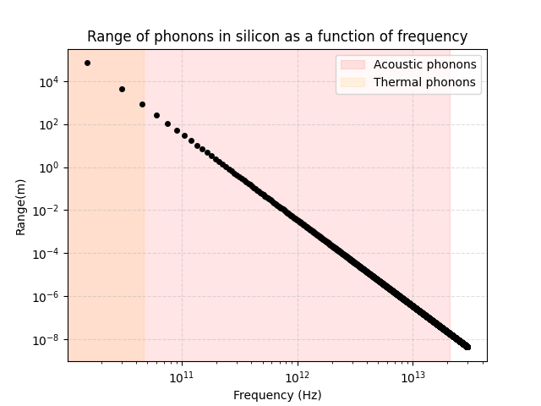
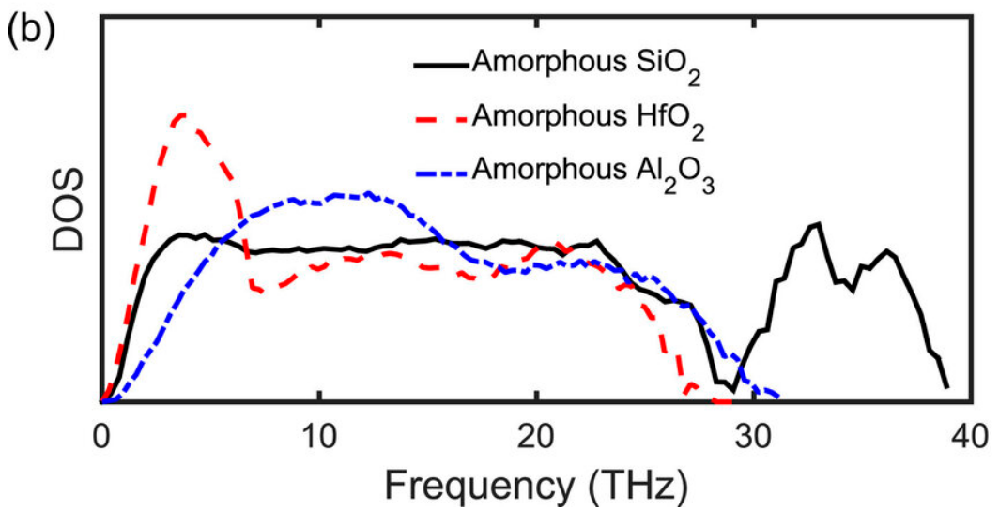
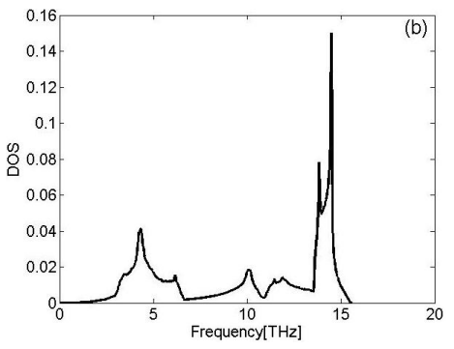
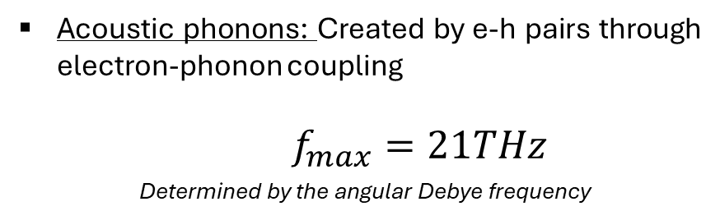
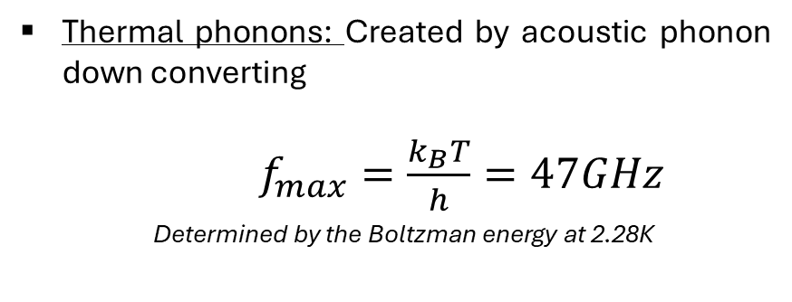
Phonon propagation in Silicon:
Acoustic phonons: Created by e-h pairs through electron-phonon coupling
$f_{max}=21THz$
Determined by the angular Debye frequency
Thermal phonons: Created by acoustic phonon down converting
$f_{max}=\frac{k_{B}T}{h}=47GHz$
Determined by the Boltzman energy at 2.28K
Phonon DOS in SiO2
Phonon DOS in Si
NTL phonons: Created by charged carriers in an electric field (Not present here)

Slide 3
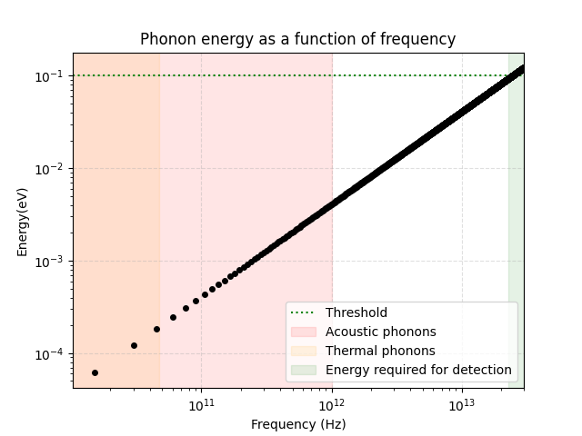
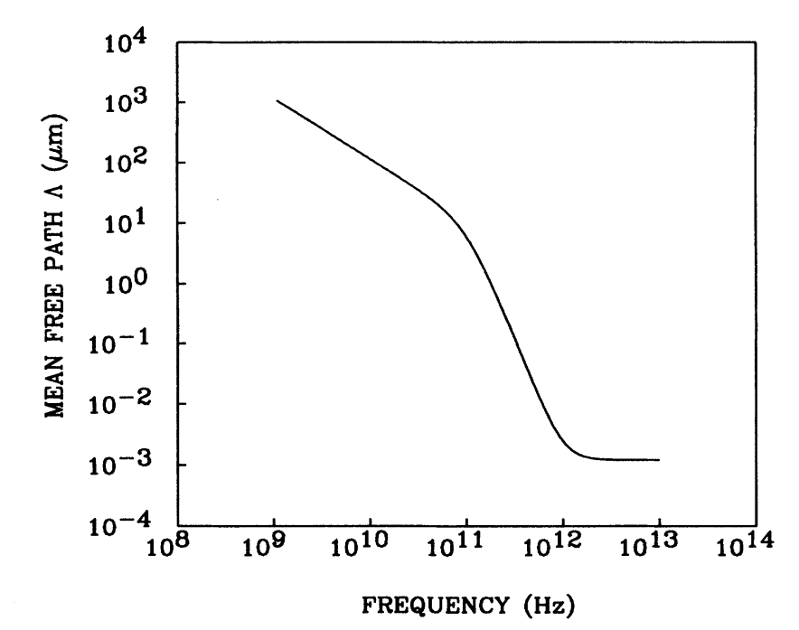
Phonon in Si/SiO2 boundary:
Acoustic phonons: Oxide layer thickness: 2nm
Maximum frequency: 1THz
Acoustic phonons: Any thermal phonon in the oxide layer will reach the SNSPD wire
NB: These remarks consider that phonons follow a ballistic propagation scheme. In reality, due to the acoustic mismatch between layers, the phonons become diffusive and convert into propagons, diffusons and locons, which drastically reduce their energy

