Slide 1

Charged particle detection with superconducting nanowire single photon detectors (SNSPDs)

Slide 2
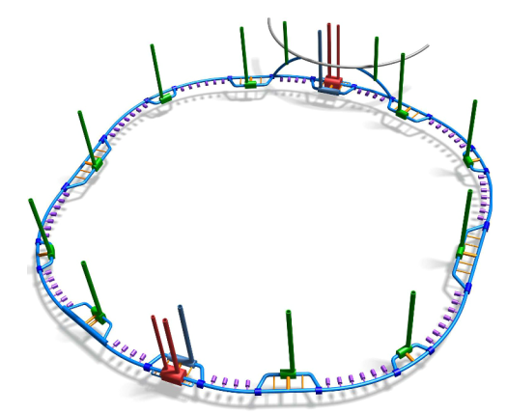
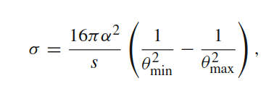
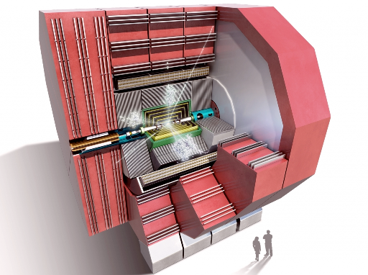
Potential use case in FCC
RF System
Interaction Points
SNSPD based Luminometer
FCC e⁺e⁻
~100 km double ring collider
2 IPs with 30 mrad crossing angle
angle 91 GeV (Z) – 365 GeV (ttbar)
Luminosity: up to 500×10³⁴ cm⁻²s⁻¹
Sub-per mill resolution through small angle Bhabha scattering
Goal of 10⁻⁴ precision on absolute luminosity
Readout at Bunch-crossing rates with < 20ns shaping time
FCC Lepton detector (CLD) based on CLICdet
Beam Axis
1 – 3 m
1 – 3 m
Luminometers
Notes:
What are the research questions, state of the art, intended contributions to the state-of-the-art?
What are the contributions of this project to the overall questions of the NCCR?
Establish the magnitude of the problem/question and who is working on it

Slide 3
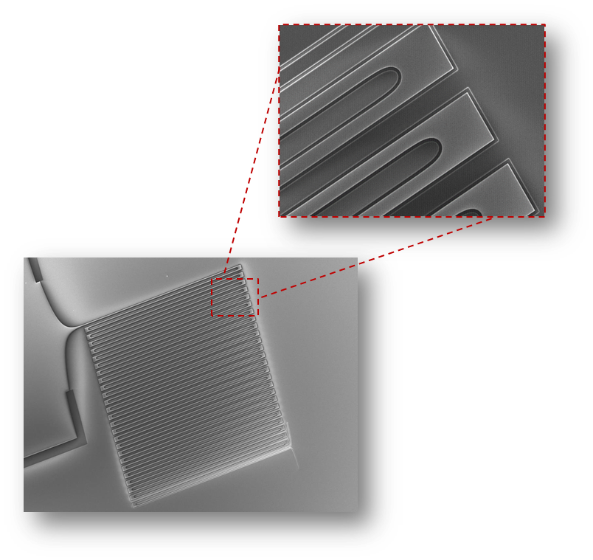
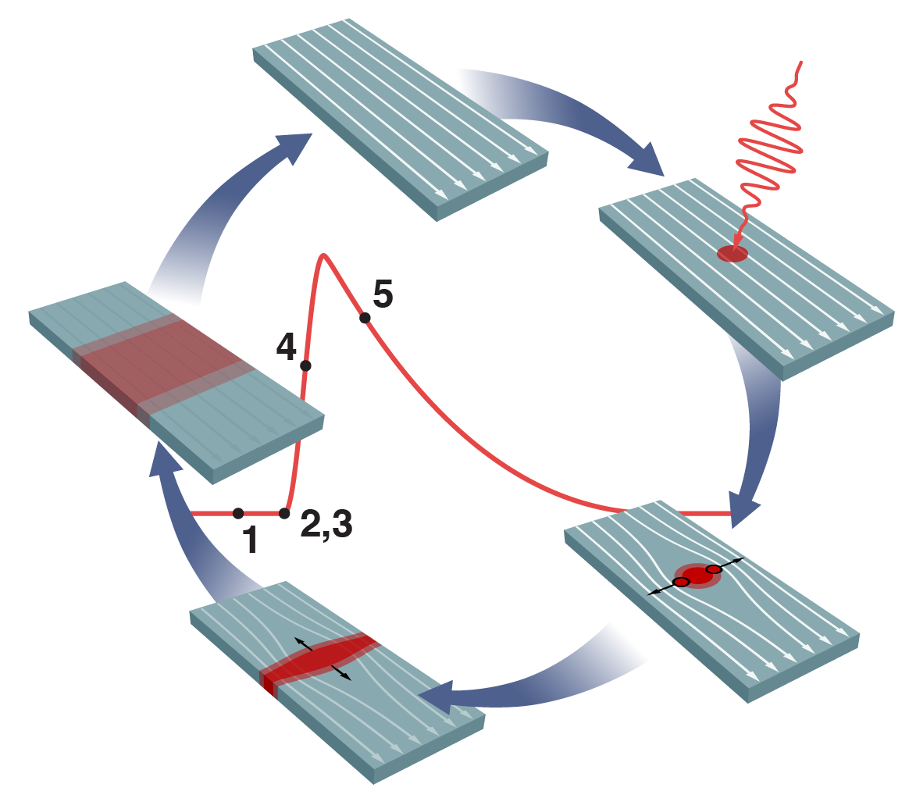
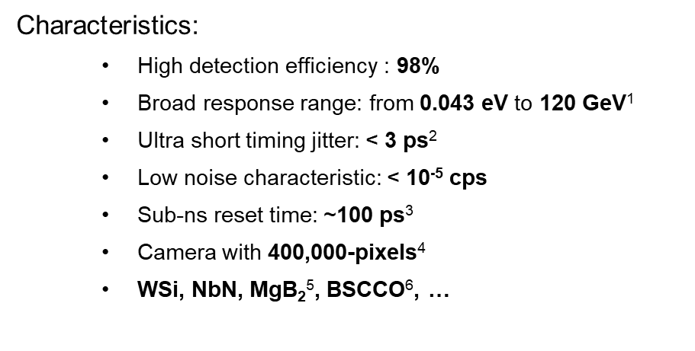
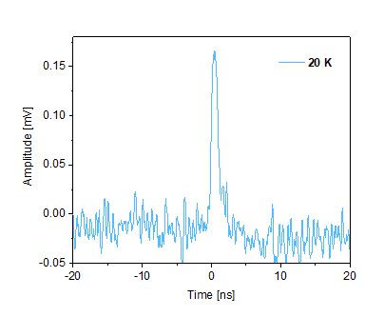
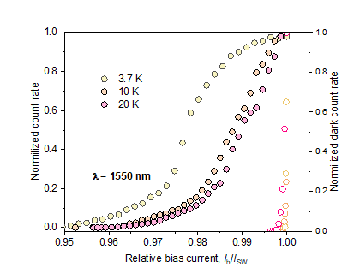
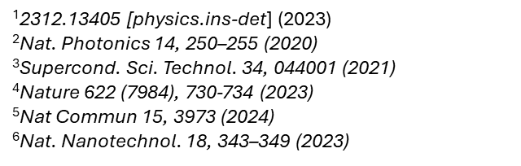
Superconducting nanowire detectors
Initially developed for photon counting, but can be used for direct particle detection or coupled to scintillators

Slide 4
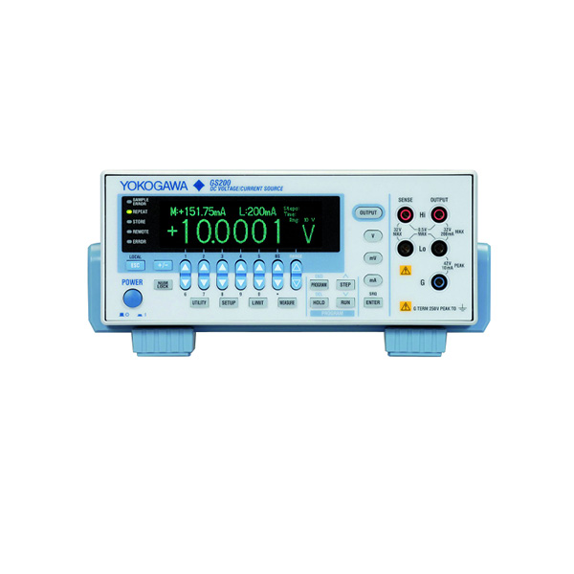
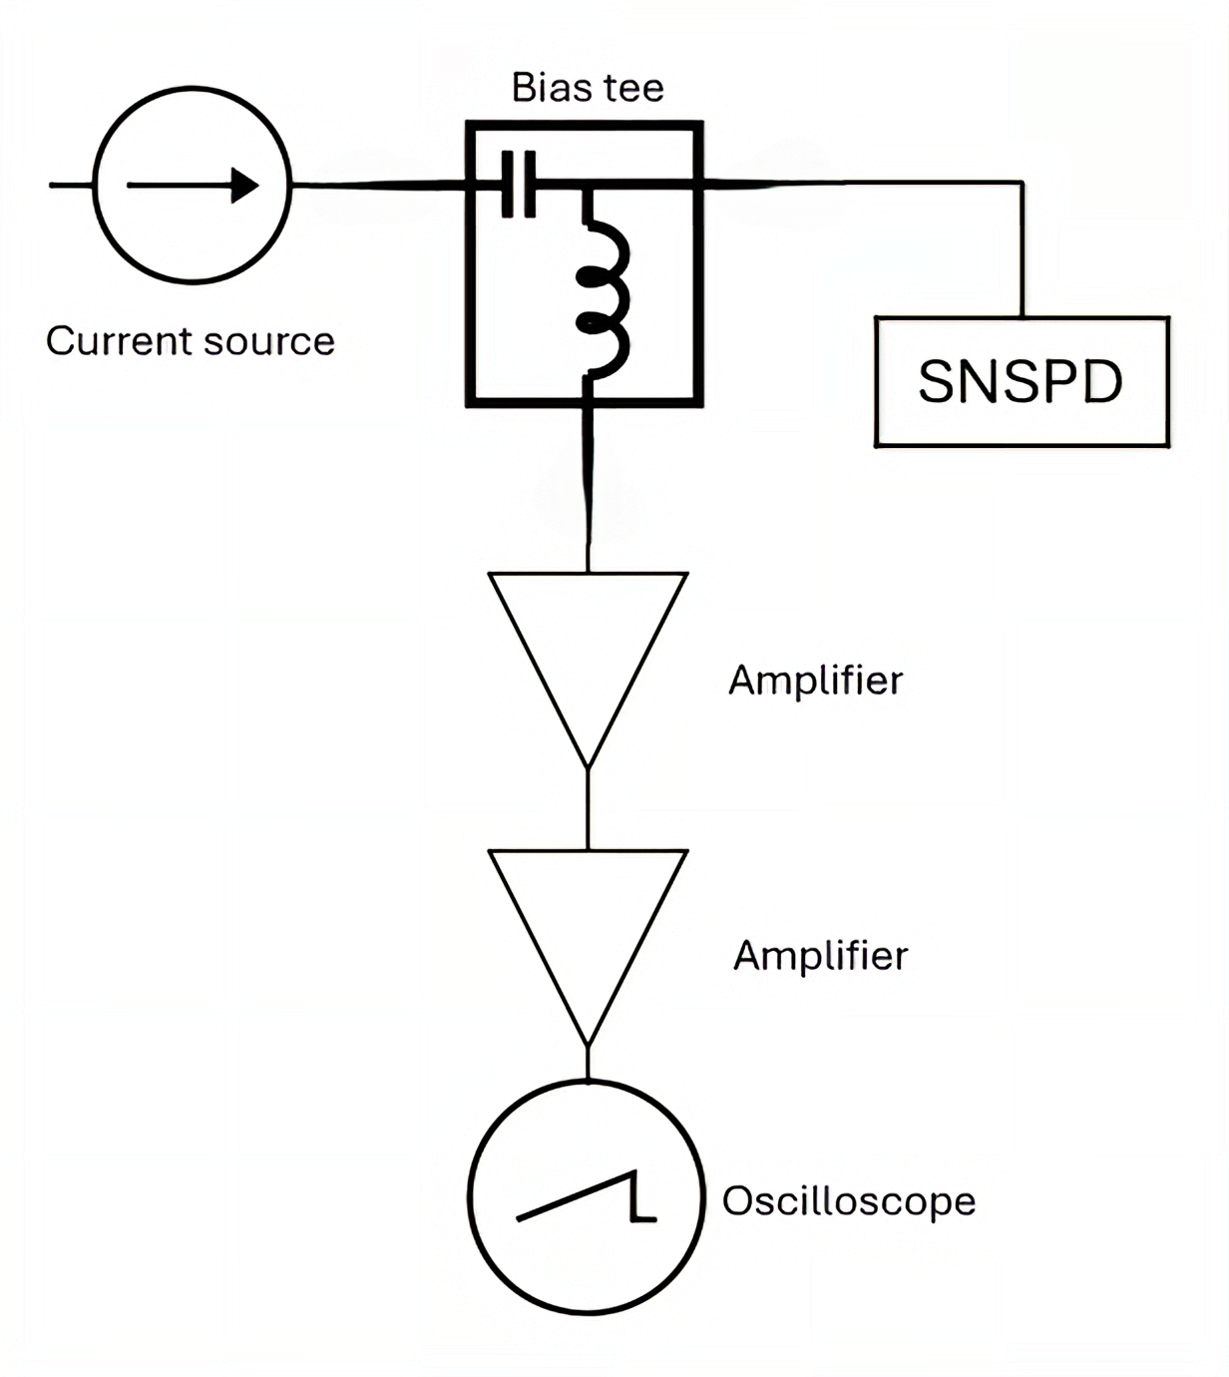

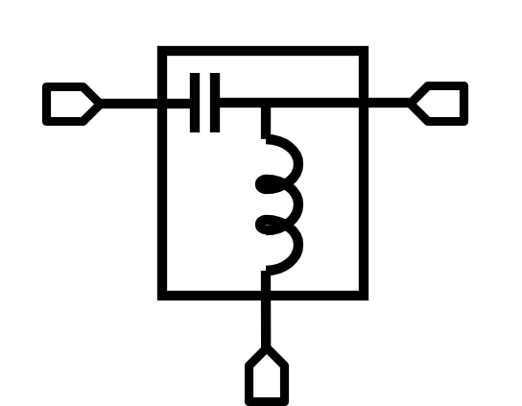
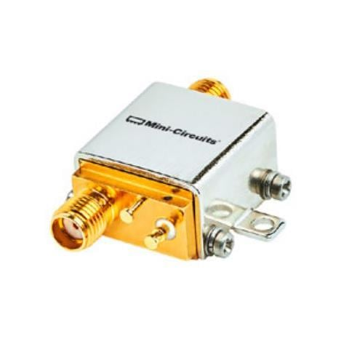
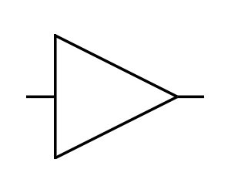
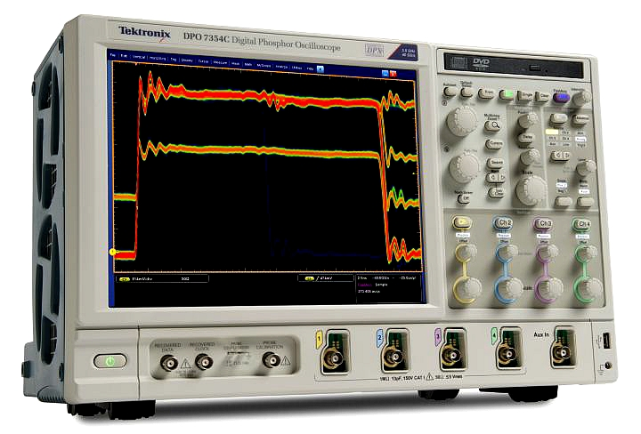

Instrument setup
Current source: Yokogawa GS200
Voltage source up to 32V
Current source up to 200mA
5 μA accuracy
Electric diagram:
DC
Bias tee
RF + DC
Bias Tee: ZX85-12G-S+
Max voltage: 25V
Max current: 400mA
RF Power: 30dBm
Bandwidth: 12GHz
Current source
SNSPD
RF
Amplifier: ZX60-3018G-S+
Bandwidth: 3GHz
Output power: 12.8dBm
Max current: 45mA
Max voltage: 12.5V
Amplifier
Amplifier
Oscilloscope: Tektronix DPO7354
Bandwidth: 3.5GHz
40GS/s
4 channels
FastAcq: 250 000 triggers/s
Oscilloscope

Slide 5
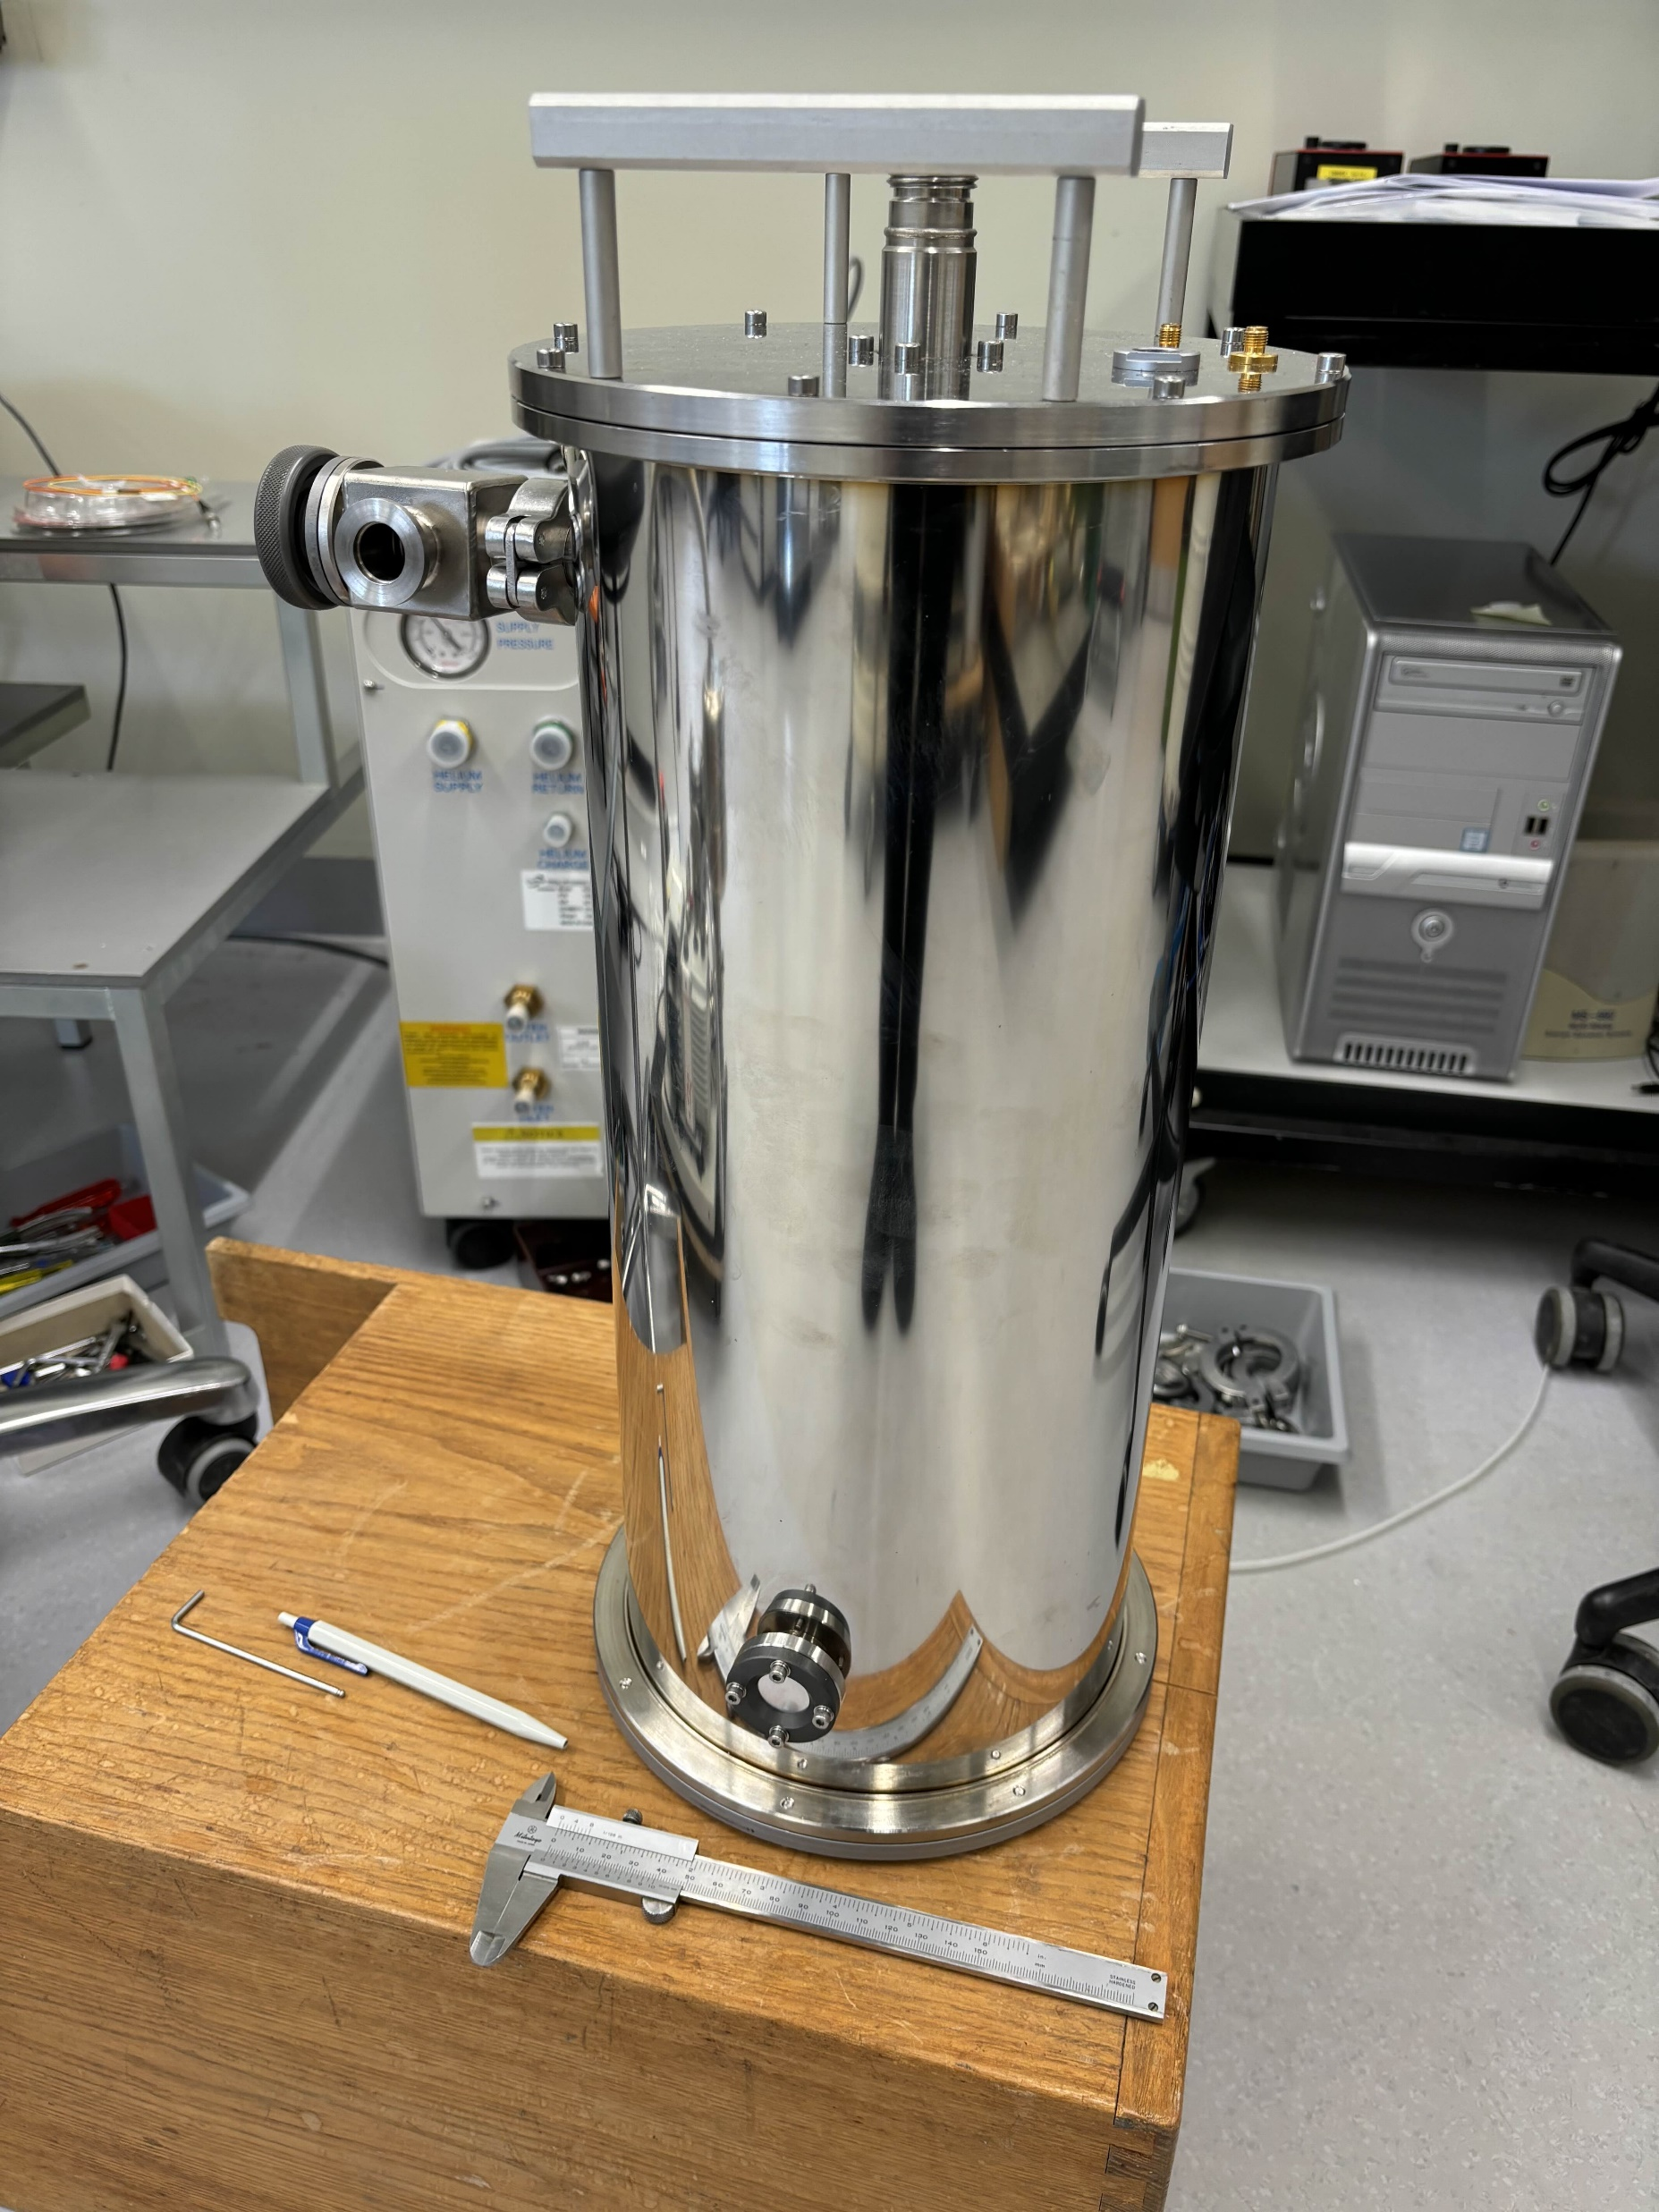
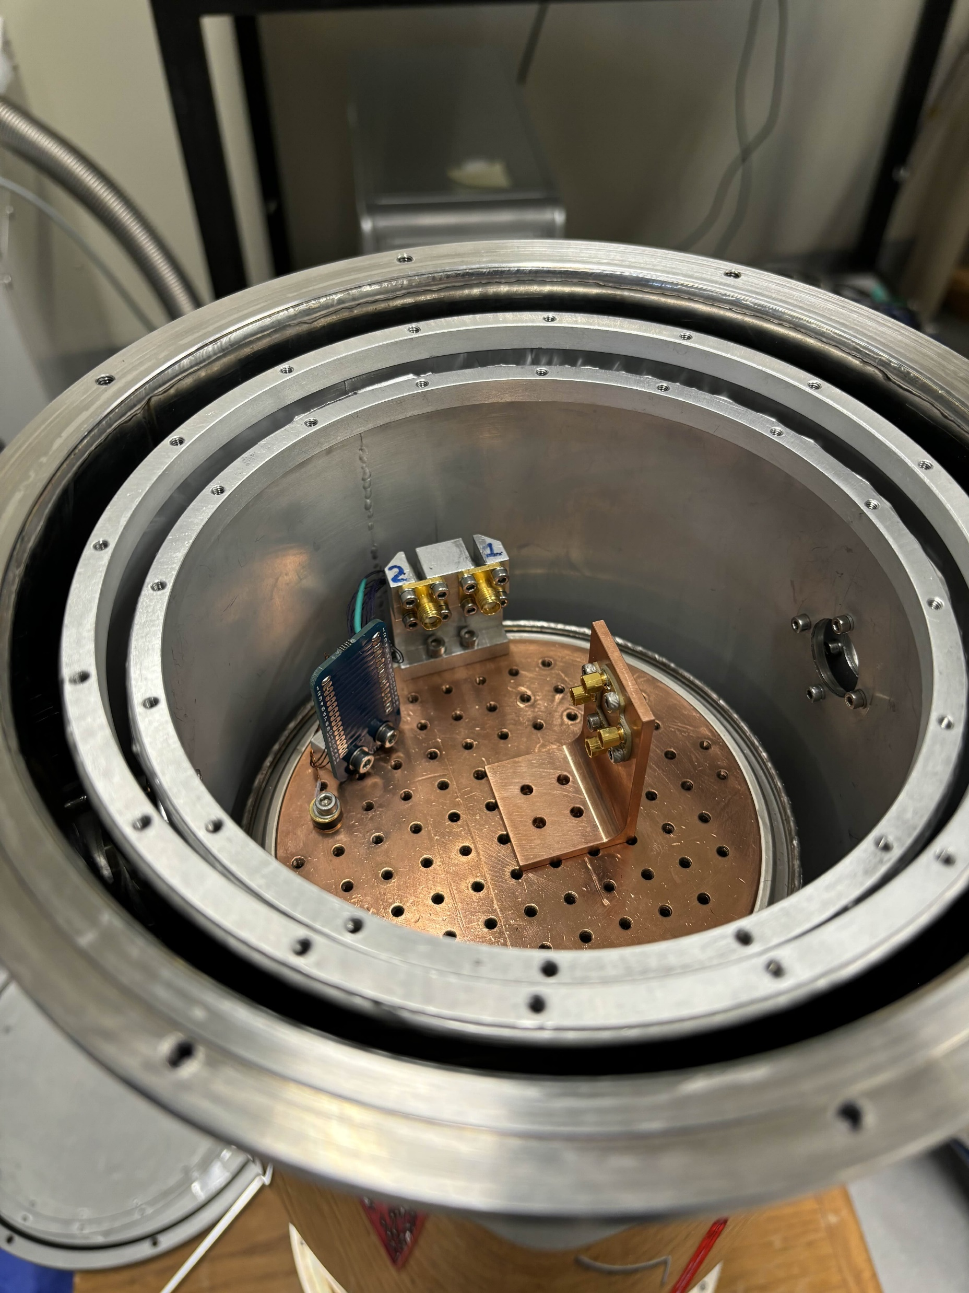
Liquid Helium cryostat
LHe cryostat:
Cooldown time: ~4h
Lowest temperature: 4.2K
Experiment time: ~8h
Advantages:
Rapid cooldown and setup
Disadvantages:
2 readout channels
Requires cooling every 24h
Window
Chip holder

Slide 6
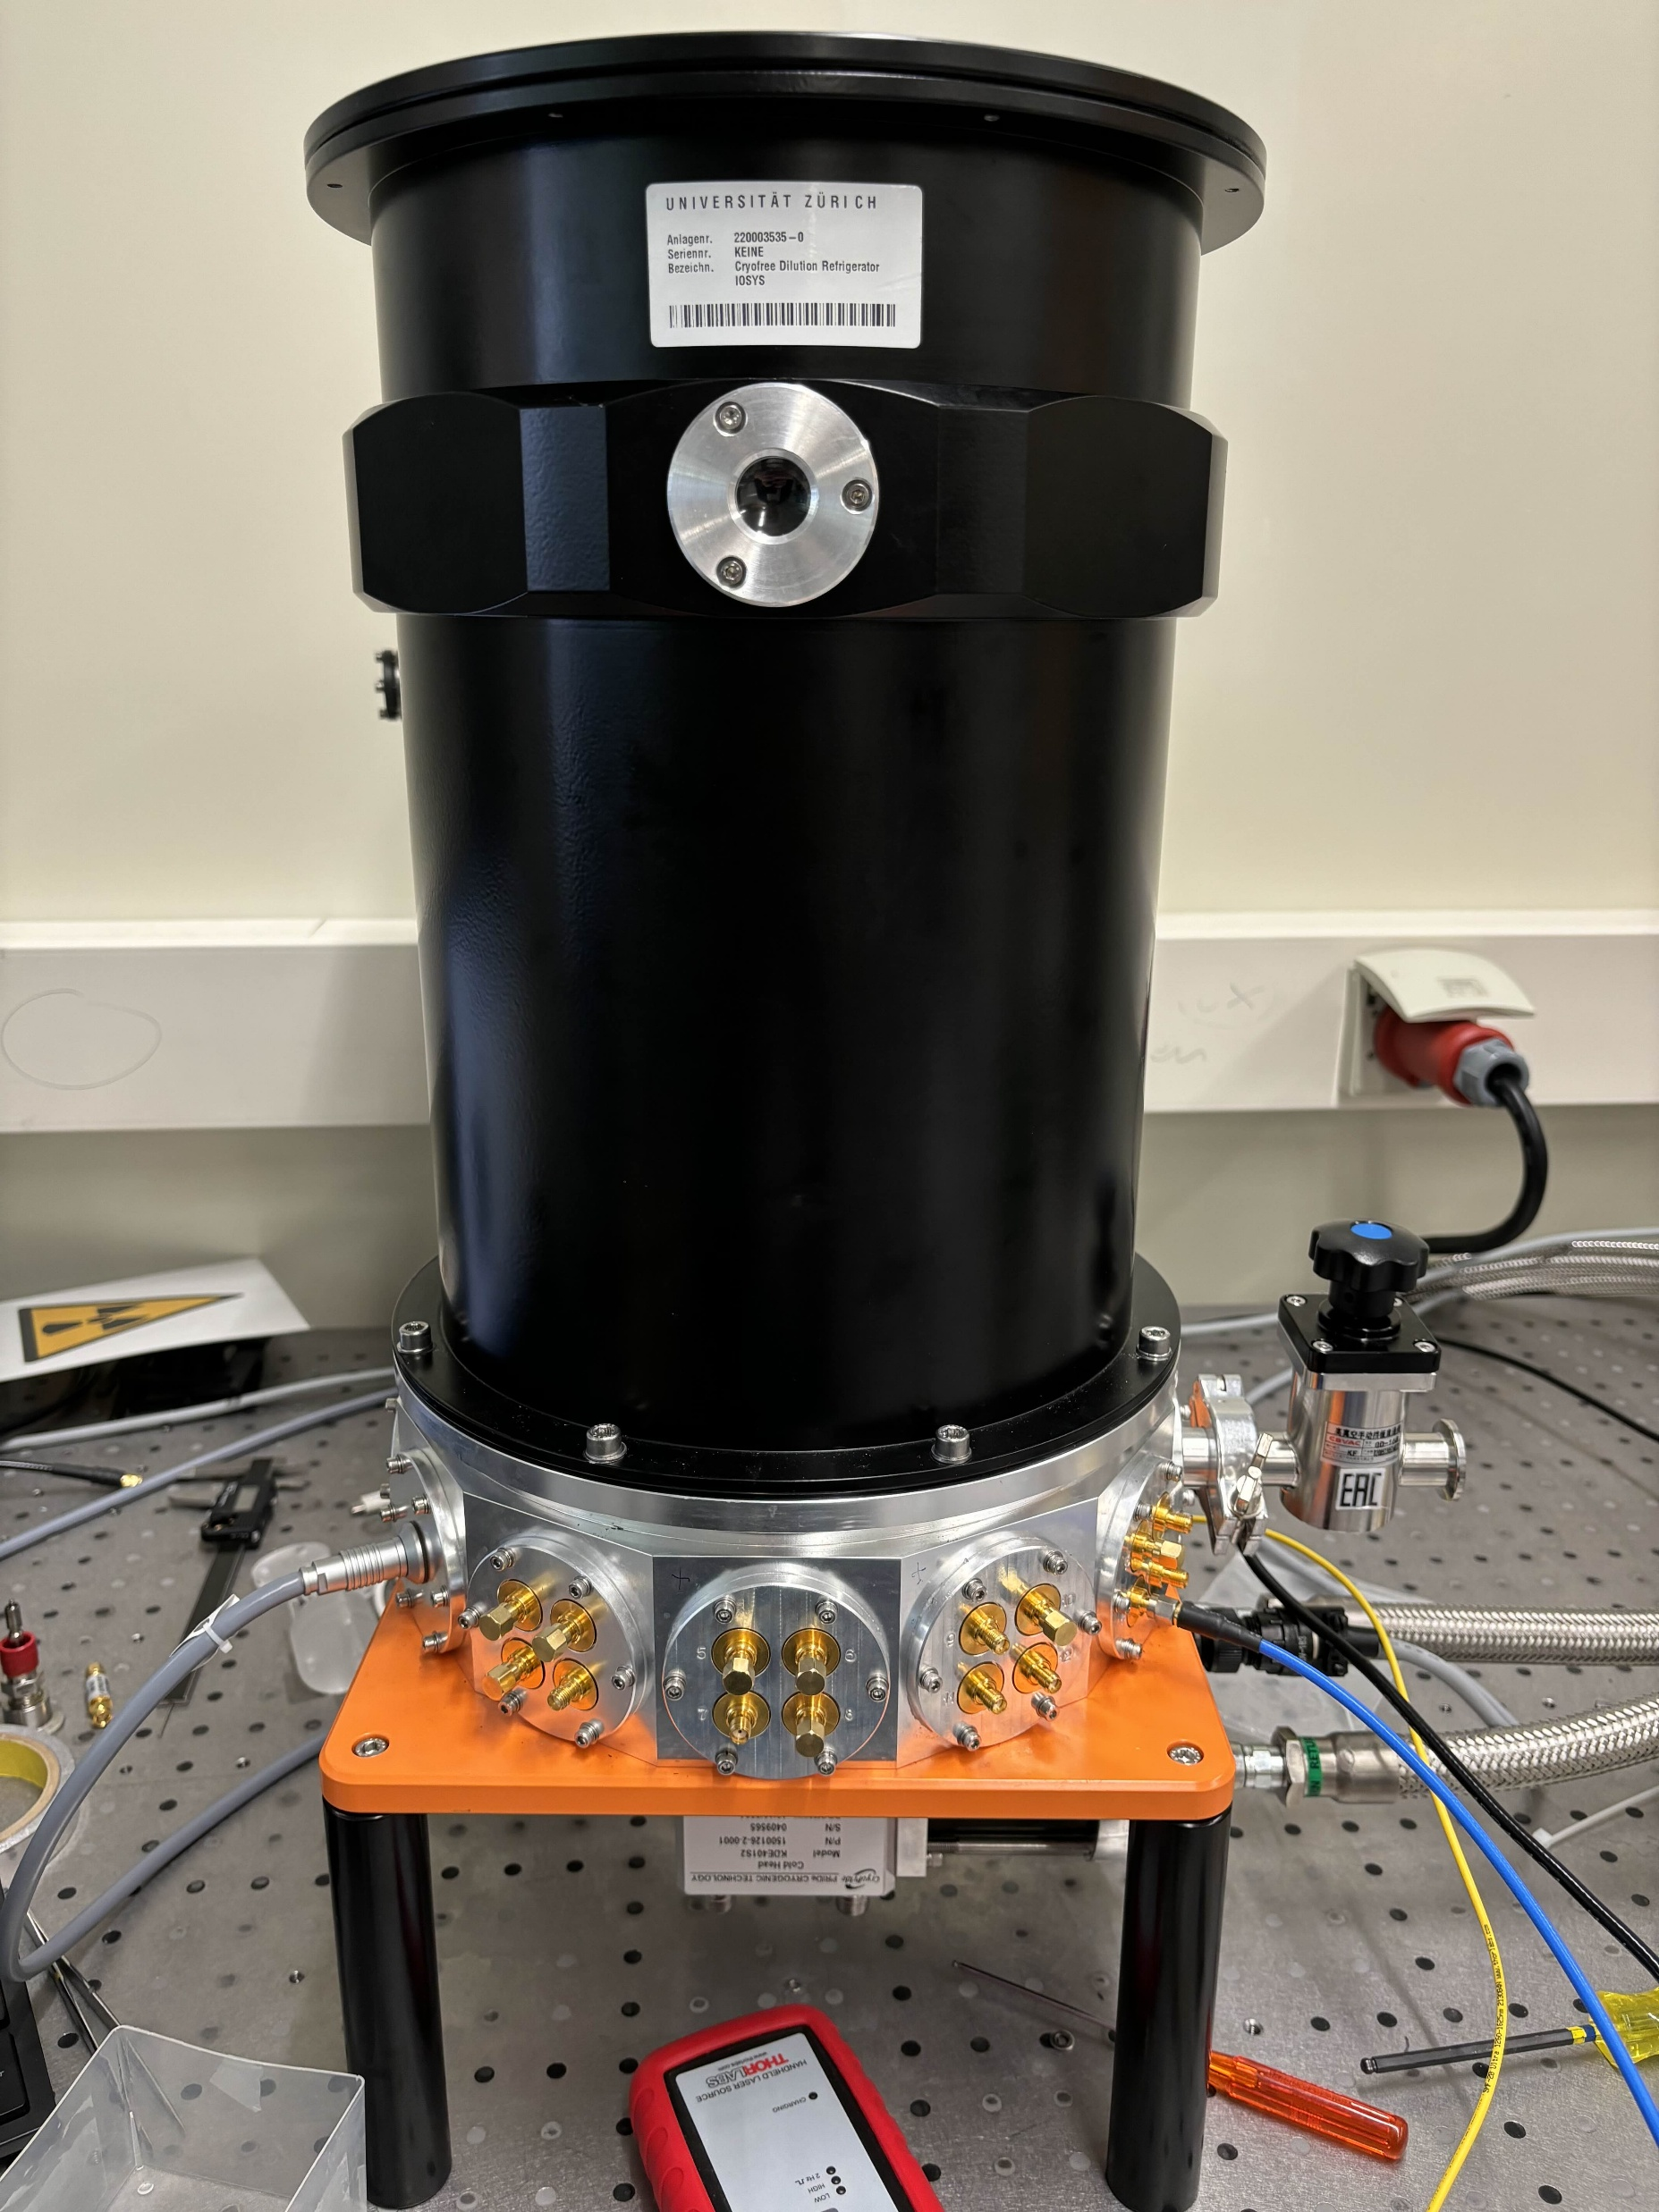
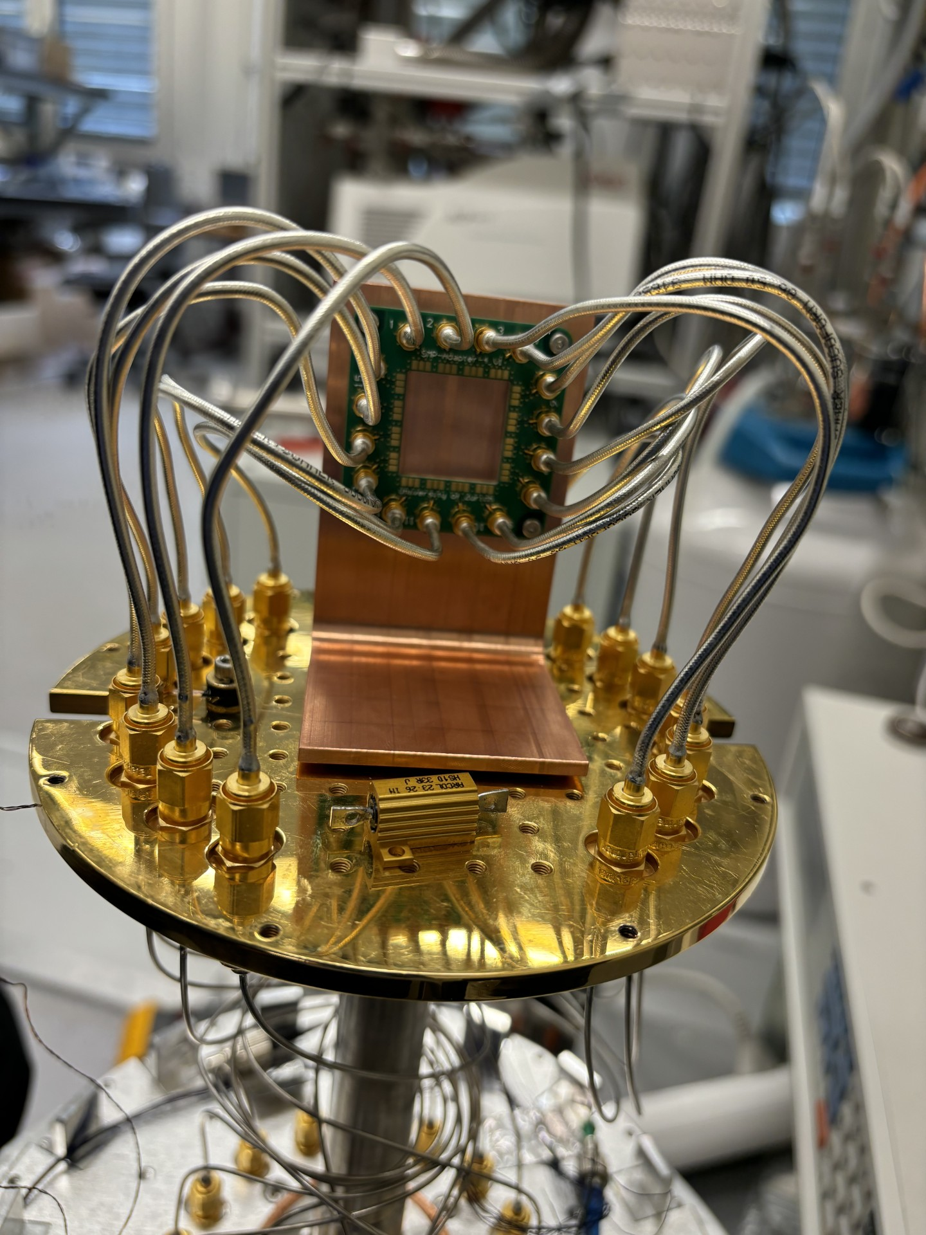
Closed cycle cryostat
Window
Closed cycle cryostat:
Cooldown time: ~8h
Lowest temperature: 2.28K
Experiment time: infinite
Advantages:
16 readout channels
No daily maintenance
Disadvantages:
Extensive setup time
Chip holder
Readout
Cold stage

Slide 7
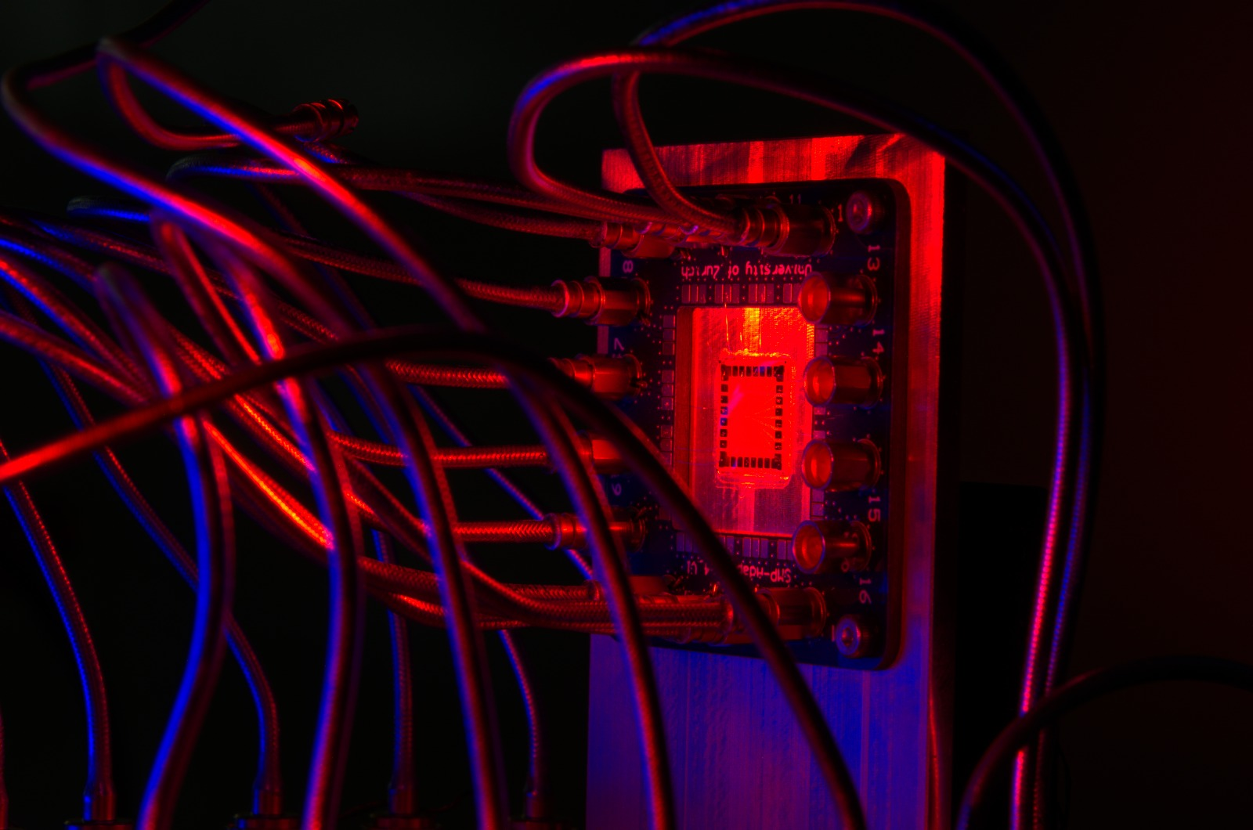
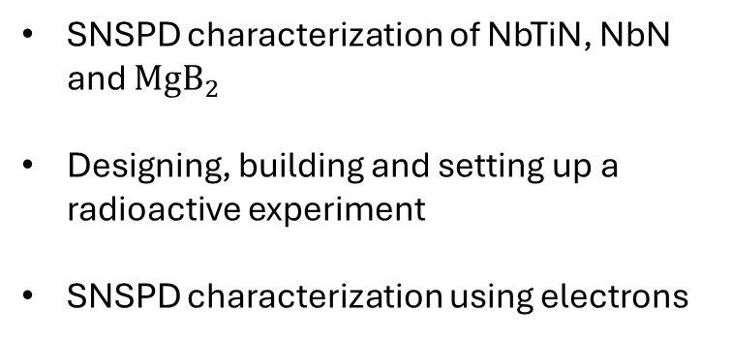
Goals of the thesis
SNSPD characterization of NbTiN, NbN and ${MgB}_{2}$
Designing, building and setting up a radioactive experiment
SNSPD characterization using electrons

Slide 8
SNSPD characterization experiment

Slide 9
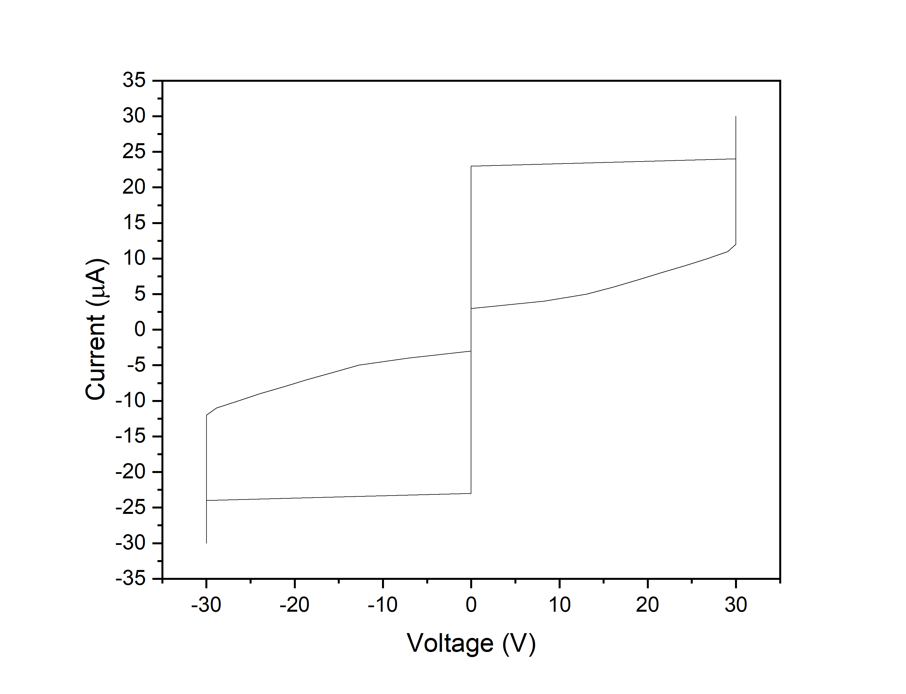


IV measurement
Example of an IV measurement
$I_{c}$Critical current
$I_{h}$ Hysteresis current

Slide 10
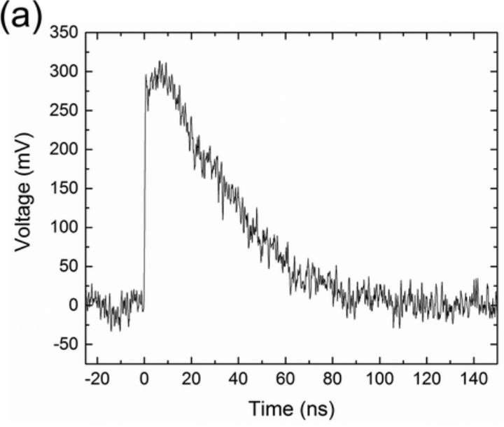
Trigger level measurement
Trigger level curve example
3
2
1

Slide 11
Photon and dark count rates
Photon count rate (PCR) example
Dark count rate (DCR) example
Photon count with a laser source
Dark counts with no laser source

Slide 12
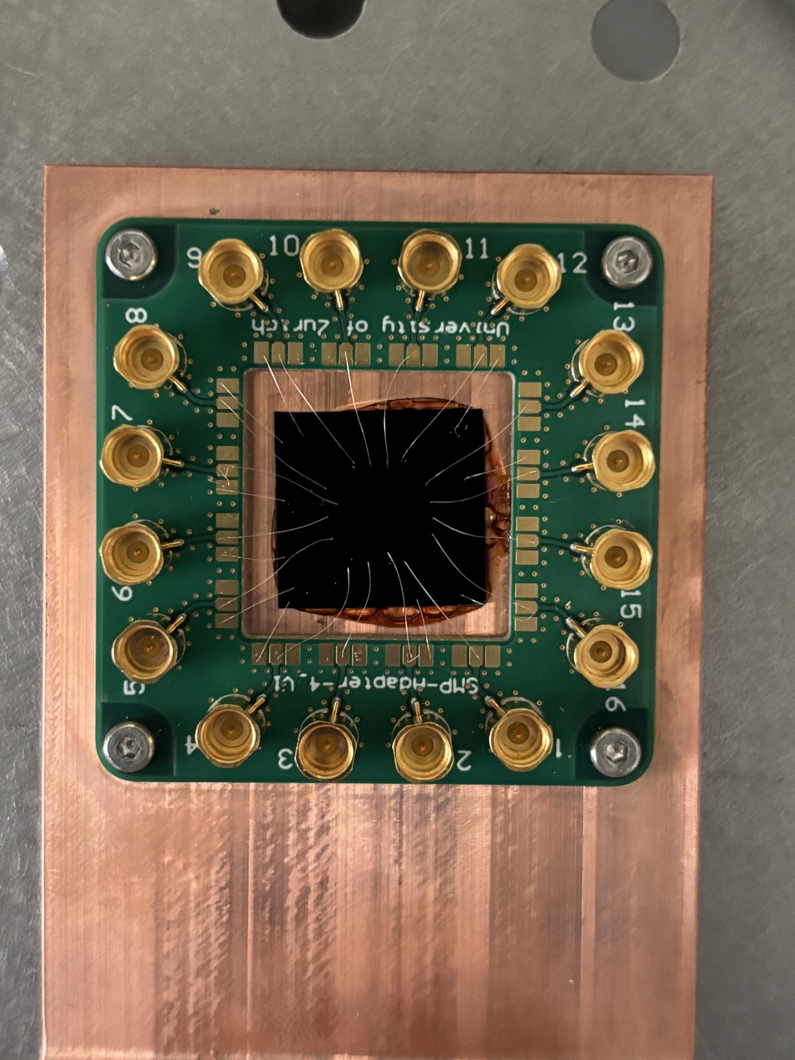
Optical characterization results

Slide 13
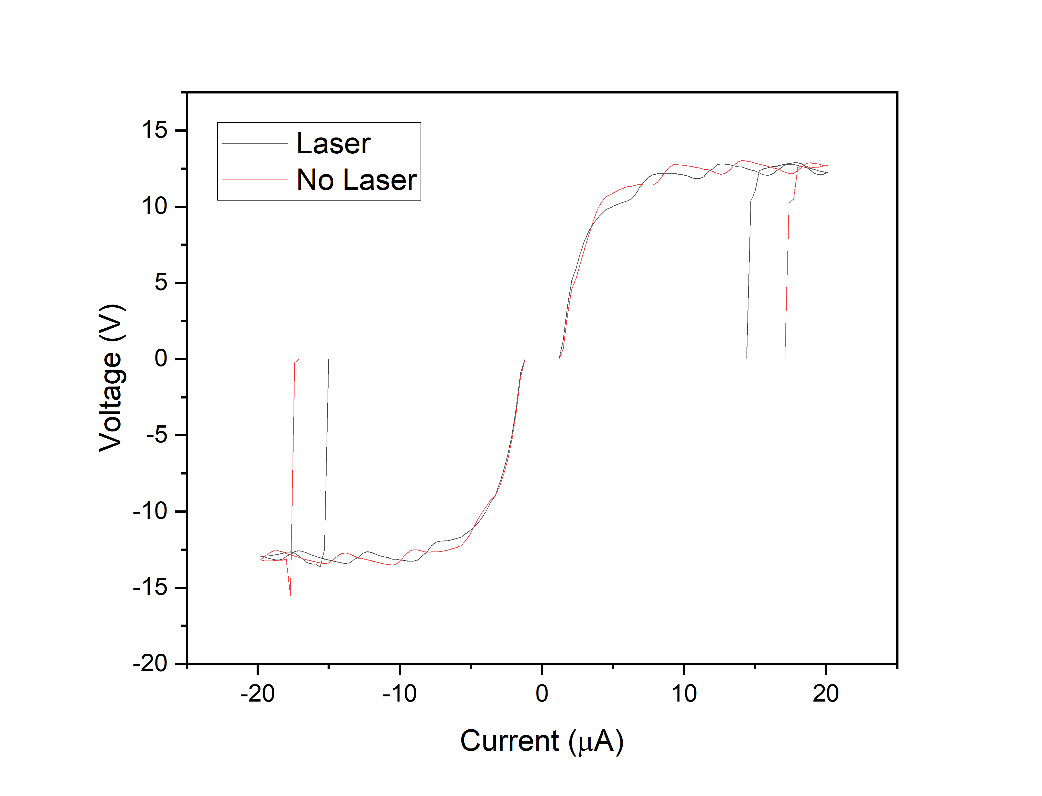
NbTiN SNSPD (A)
IV curve
Trigger level
PCR
DCR

Slide 14
NbTiN SNSPD (B)
IV curve
PCR vs DCR comparison

Slide 15
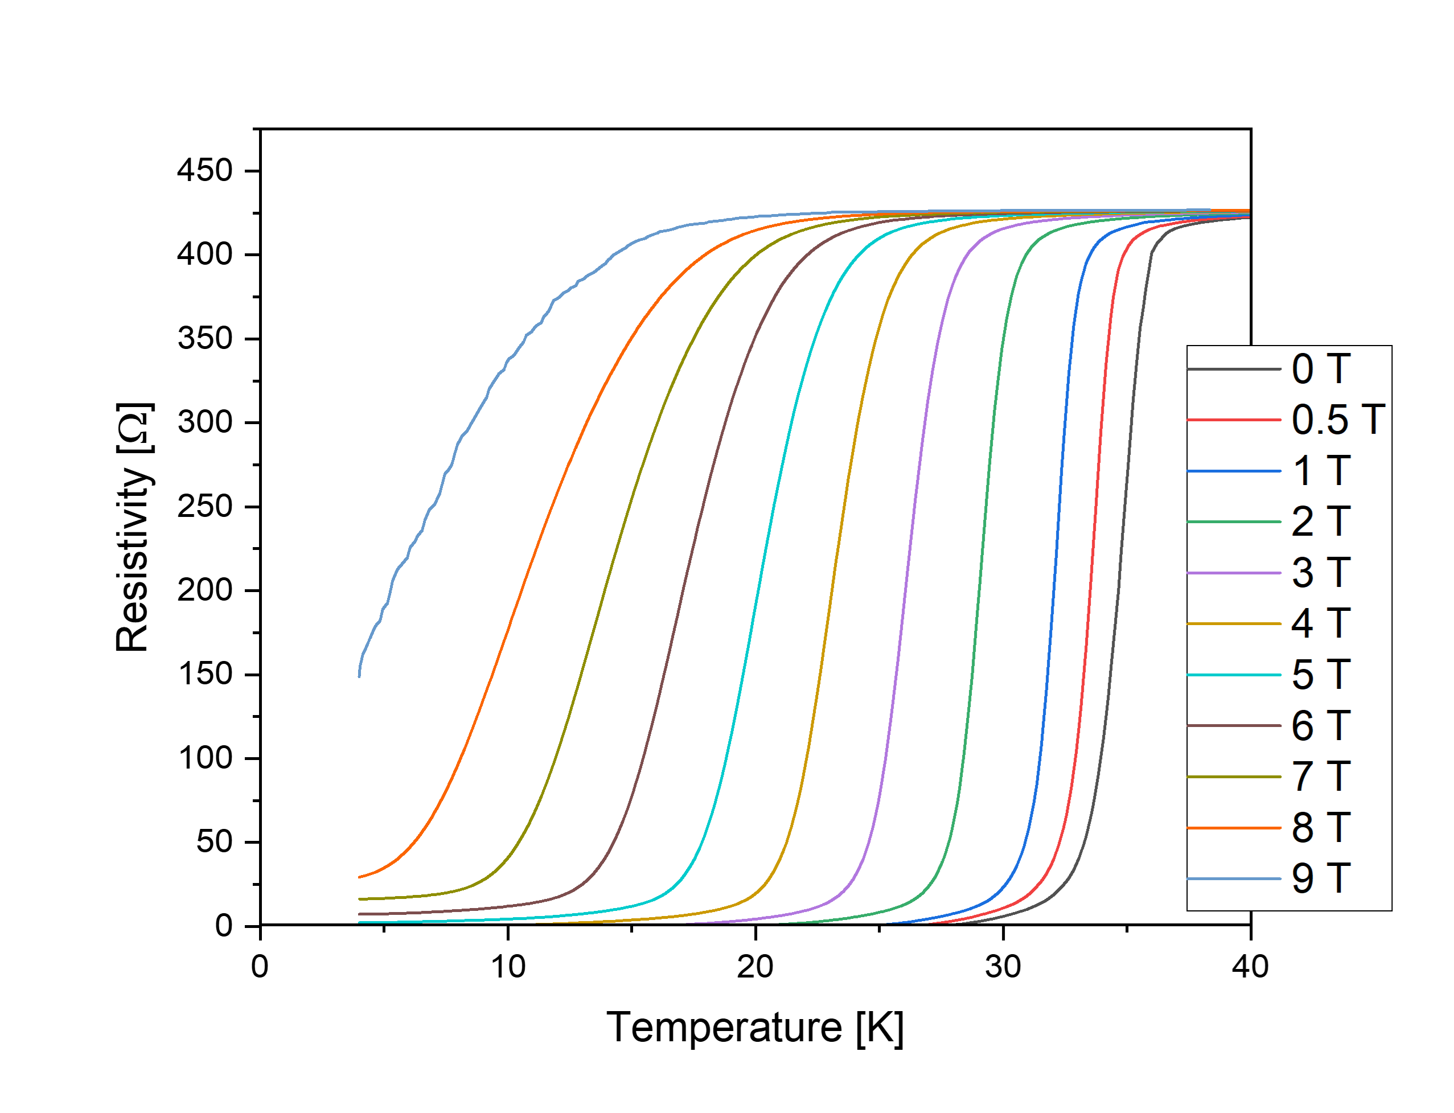
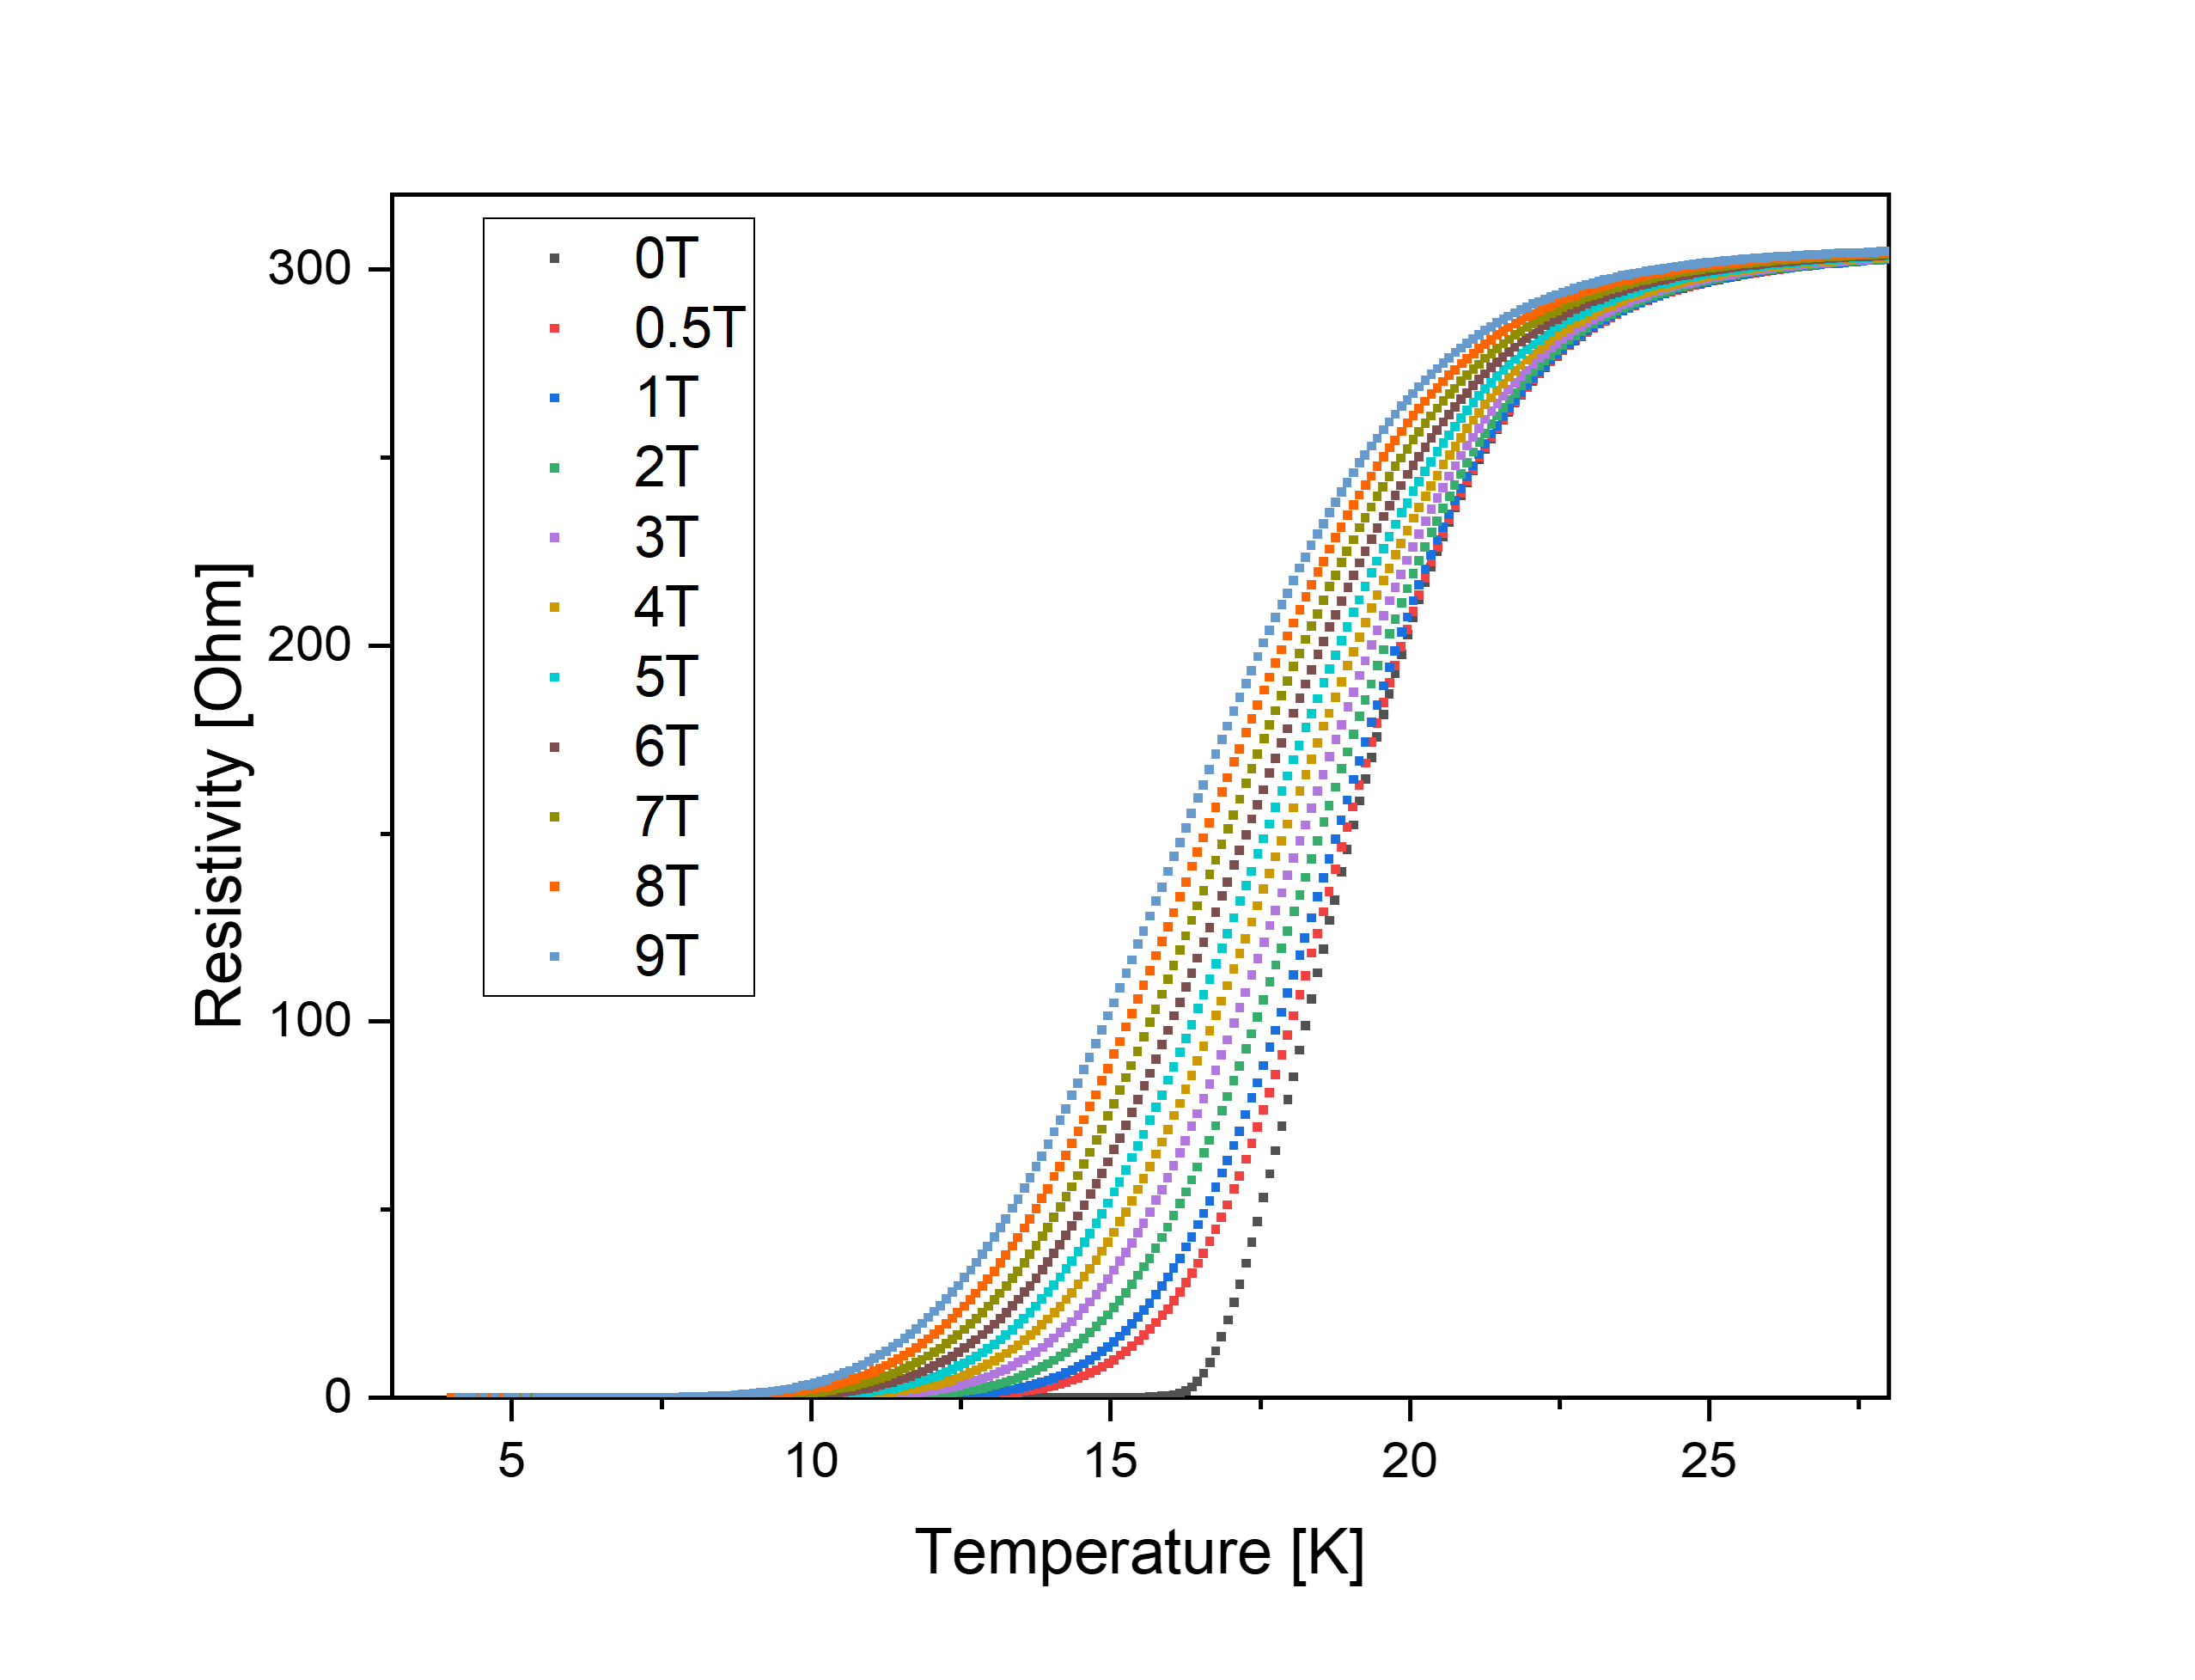
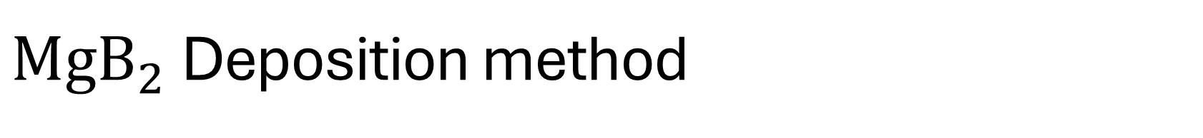
${MgB}_{2}$Deposition method
HPCVD
Tc ~ 35K
Magnetron sputtering
Tc ~ 17K

Slide 16
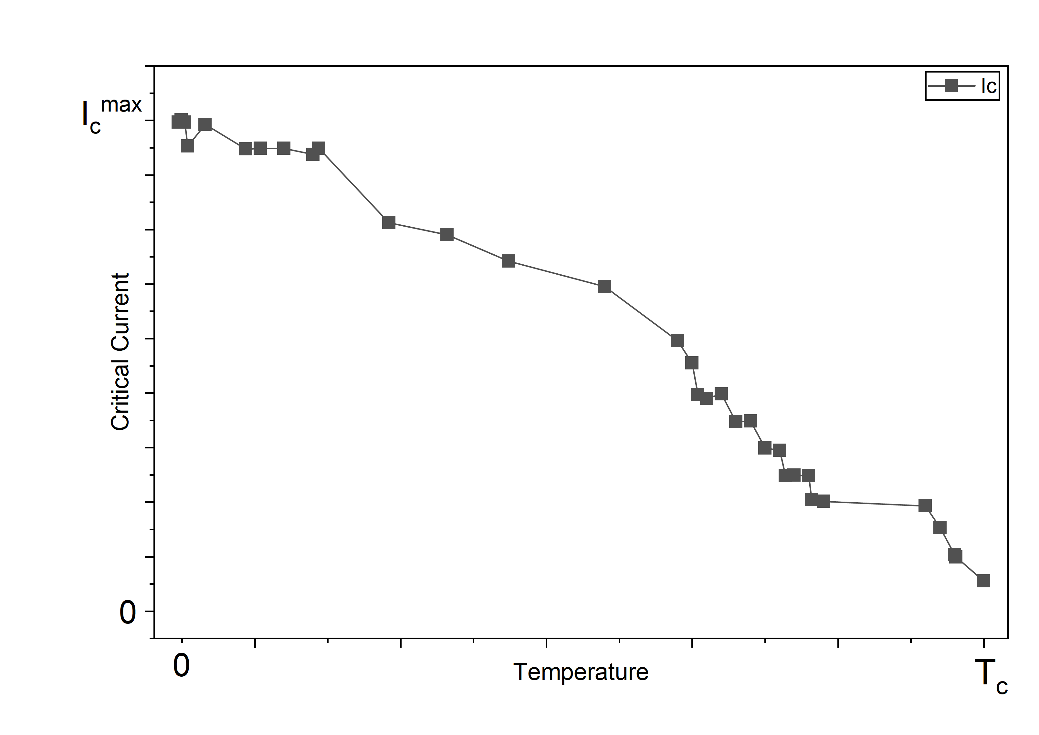
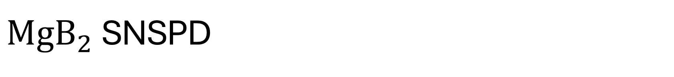
${MgB}_{2}$SNSPD
Critical current vs wire width
Hysteresis current vs wire width
IV curve
Critical current vs temperature

Slide 17
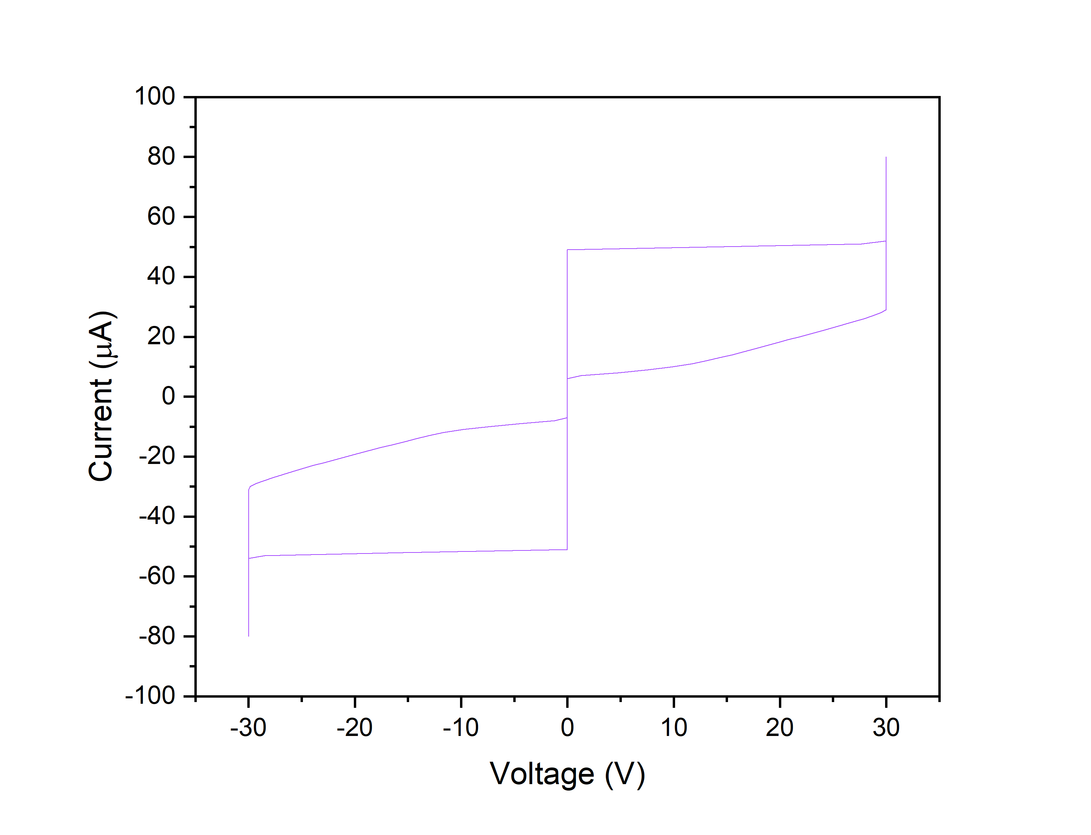
NbN SNSPD
IV curve
Trigger level
PCR
DCR

Slide 18
Radioactive experiment

Slide 19
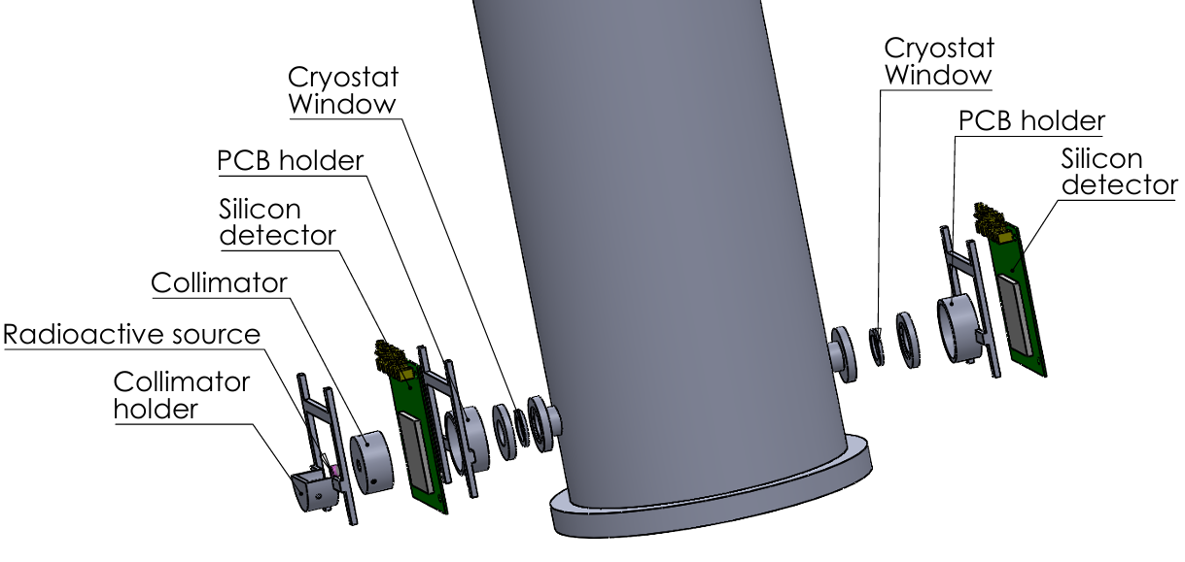
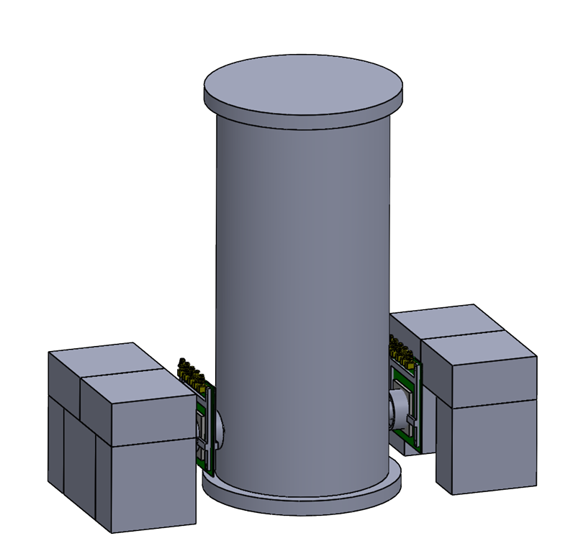
Experimental setup
Cryostat
Lead castles
Cryostat piece
Cryostat piece

Slide 20

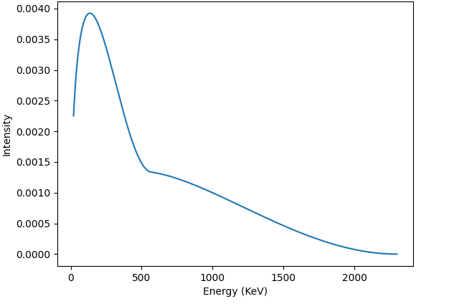
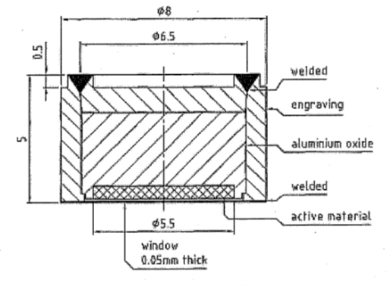
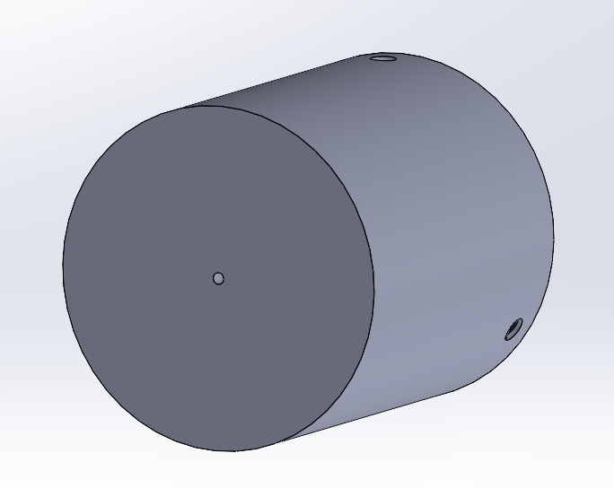
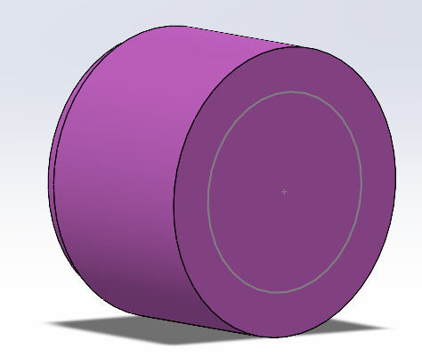
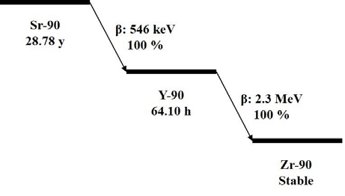
Strontium90 source
Strontium90 beta spectrum
28 MBq source (originally 37MBq)
550 KeV decay energy (Strontium 90)
Into 2.3 MeV decay energy (Yttrium 90)
Bought: 26/03/2012
Serial number: VZ-3721-001
Strontium90 decay chain
Collimator model
Radioactive source model

Slide 21
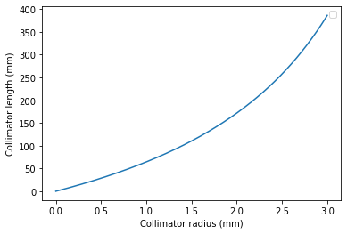
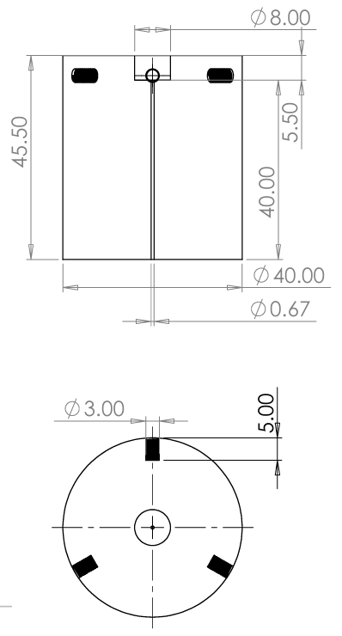


Collimator design
SNSPD
Ray casting diagram
2.5+0.5x mm
Radioactive
source
x
Collimator
128.8mm
y
$$\frac{2.5+0.5x}{128.8+y}=\frac{x}{y}$$
$$y=\frac{128.8x}{2.5−0.5x}$$
Minimum plexiglass thickness: 1.6cm
Length of collimator: 4cm
Collimator opening: 0.67mm
Collimator length as a function of collimator radius
Collimator model

Slide 22
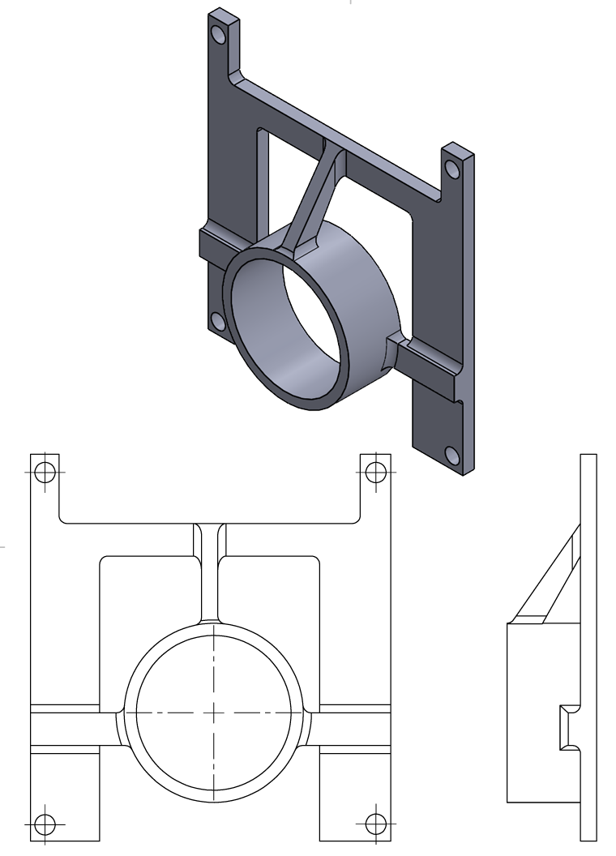
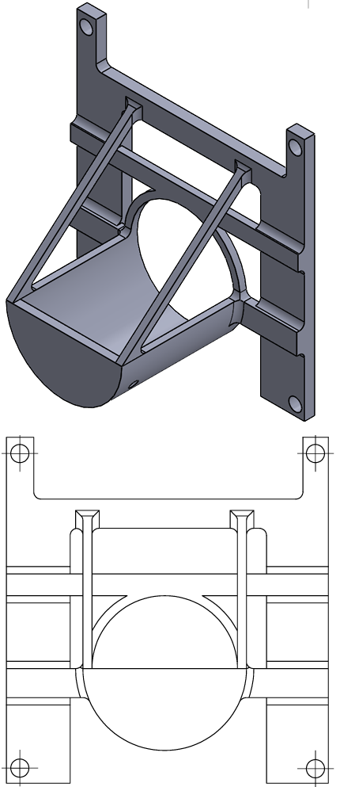
Holder design
Collimator holder
LGAD holder

Slide 23
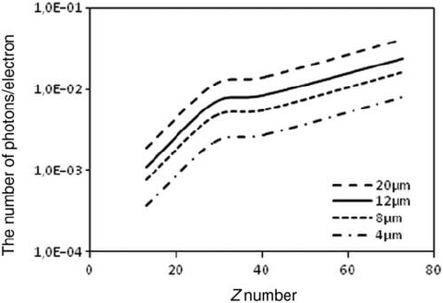
Cryostat window issues
Cryostat window requirements:
Low Z material
Small beta spectrum attenuation
Opaque (optional)
Low cost
Vacuum resistant
As we can see, bremsstrahlung cross section increases with Z.
The current window installed on the cryostat is a 2.5mm thick, aluminium window, which will create bremsstrahlung radiation and thus unwanted dark rates, making it unusable.

Slide 24

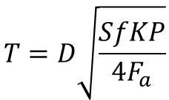

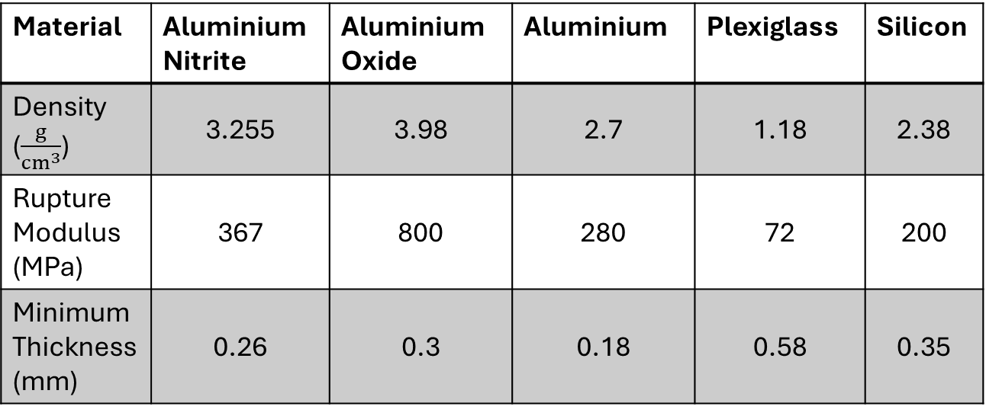
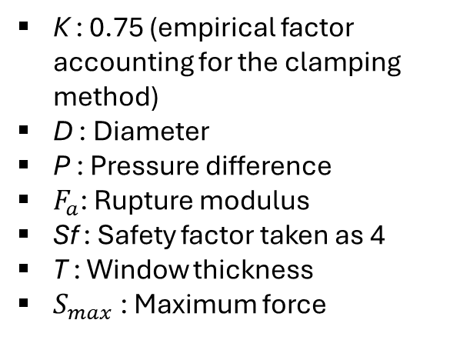
Cryostat window minimum thickness
Minimum window thickness equation:
Material | Aluminium Nitrite | Aluminium Oxide | Aluminium | Plexiglass | Silicon
Density ($\frac{g}{cm^{3}}$) | 3.255 | 3.98 | 2.7 | 1.18 | 2.38
Rupture Modulus (MPa) | 367 | 800 | 280 | 72 | 200
Minimum Thickness (mm) | 0.26 | 0.3 | 0.18 | 0.58 | 0.35
$$S_{max}=\frac{KD^{2}P}{4T}=\frac{F_{a}}{Sf}$$
$$T=D\sqrt{\frac{SfKP}{4F_{a}}}$$
K : 0.75 (empirical factor accounting for the clamping method)
D : Diameter
P : Pressure difference
$F_{a}$: Rupture modulus
Sf : Safety factor taken as 4
T : Window thickness
$S_{max}$ : Maximum force

Slide 25
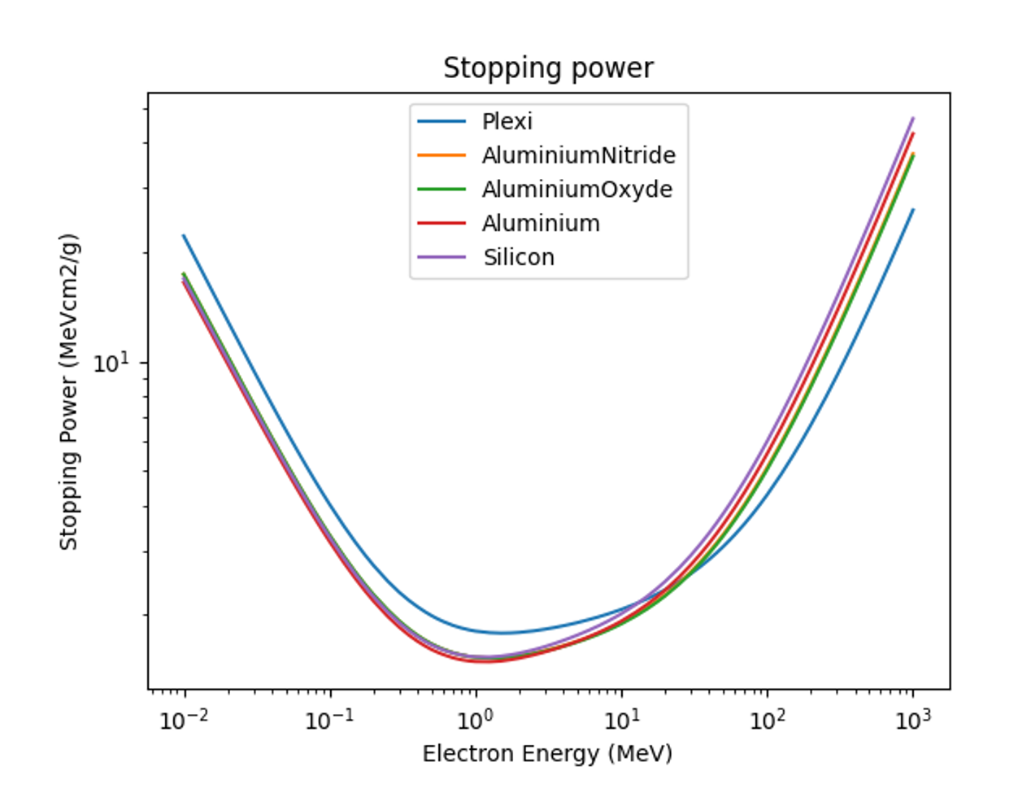

Stopping power analysis
The data was taken from the NIST ESTAR database

Slide 26
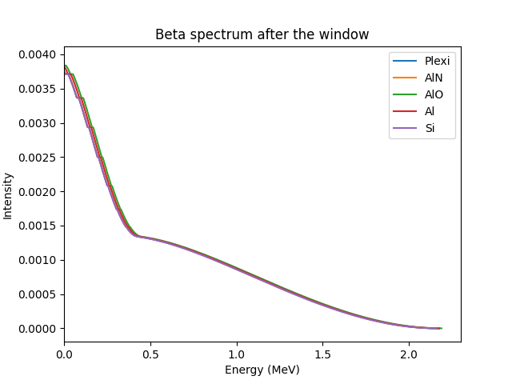
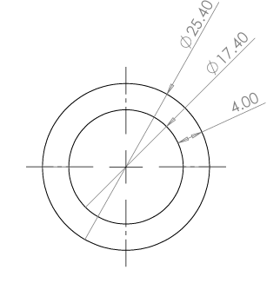
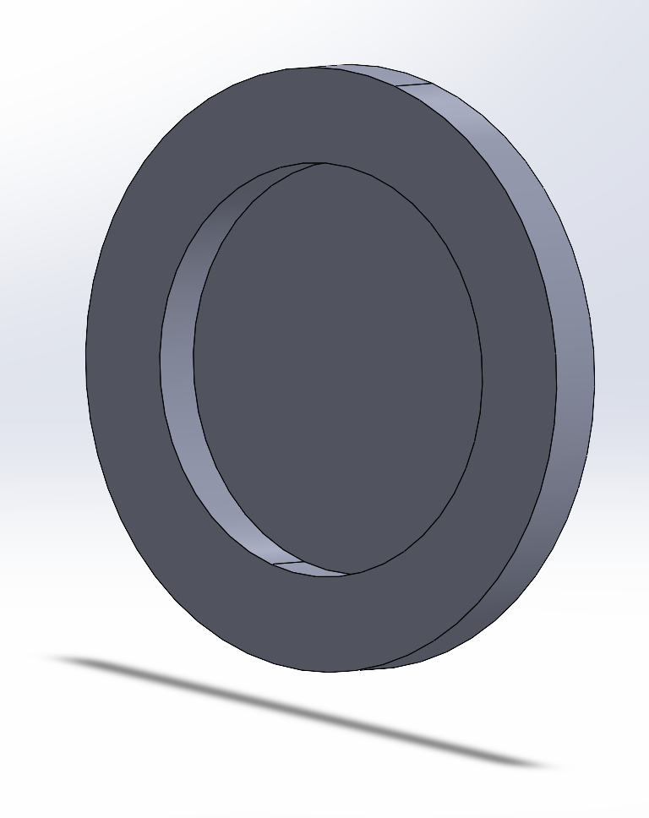

Beta Spectrum analysis
Beta Spectrum formula:
$$N\left(K\right)=\sqrt{K^{2}+2Kmc^{2}}{\left(Q−K\right)}^{2}\left(K+mc^{2}\right)F(Z,K)$$
$$F\left(Z,K\right)=\sqrt{A+\frac{B}{E−1}}$$
K : Kinetic energy
Q : Total energy
m : Electron mass
c : speed of light
E : Total electron energy
A,B : Constants specific to the radioactive source
F(Z, K) : Fermi correction to the spectrum
The energy lost by electrons in MeV/cm was calculated as the product of the stopping power and the material density
Because the beta spectrum is very similar among the five materials, we have decided to make the cryostat windows out of Plexiglass !
Window model

Slide 27
Radioactive experiment results

Slide 28


NbTiN SNSPD (A)
Comparison between having the source present or not
Window and foil:
Prevents ~90% of dark counts
Stops the low energy electrons
Creates x-rays through Bremsstrahlung
Only foil:
More dark counts
Better Beta spectrum
Small number of x-rays created

Slide 29
NbTiN SNSPD (A)
Recorded counts for varying duration
Poisson fit of recorded counts per 3s
Median background rate: 7/s
Median radioactive rate: 6/s

Slide 30

NbN SNSPD
Normalized counts as a function of bias current

Slide 31
NbTiN SNSPD (B)
Poisson fit of recorded counts per 3s
Counts as a function of duration
Median particle rate: 1.03/s

Slide 32
NbTiN SNSPD (B)
The signal !
τ
τ = 196ns

Slide 33

Conclusion
NbTiN, NbN and ${MgB}_{2}$ SNSPDs have been characterized
Radioactive experiment was designed, built and setup
Electron detection using NbTiN and NbN SNSPDs
First NbTiN SNSPD electron signal obtained

Slide 34

Thank you !
Any questions ?

Slide 35



Photon count correction
Dead time correction comparison
Due to the dead time inherent to SNSPDs and the instruments used, a correction to the counts might be necessary. The SNSPD is considered to be paralyzable (20ns), and the photon counter was approximated to a non paralyzable instrument with 5ns dead time.
Paralyzable dead time correction:
$$n=\frac{m}{1−mτ}$$
Non-paralyzable dead time correction:
$$n=me^{−mτ}$$

